Slide 1
Image-Based Proxy Accumulation for Real-Time Soft Global Illumination
Peter-Pike Sloan, Naga K. Govindaraju,
Derek Nowrouzezahrai*, John Snyder
Microsoft
*now at the University of Toronto

Slide 2
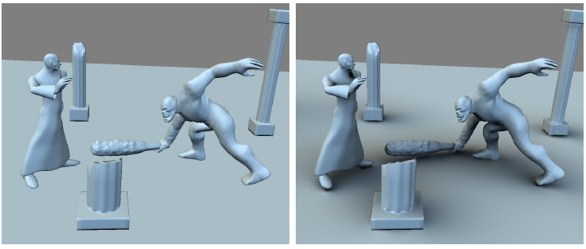
Goal: Soft Global Illumination in Dynamic Scenes
soft shadows
Notes:
Our goal is real-time rendering of dynamic scenes with moving characters.
We want to capture soft global illumination effects produced by large light sources.
Our technique produces the soft shadows in this example, which add realism and provide critical spatial cues.

Slide 3
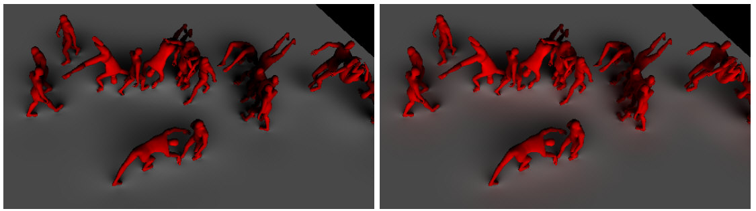
Goal: Soft Global Illumination in Dynamic Scenes
soft shadows
diffuse (indirect) inter-reflections
Notes:
Our technique also approximates inter-reflections as shown in the image on the bottom of this figure.

Slide 4
Previous Work in
Fast Shadow Rendering
Name | Reference | Lighting | Constraints
shadow buffer/vol. | [Williams78],… | point | -
accum. buffer | [Segal92],… | small area | many passes
PRT (SH) | [Sloan02],… | low-freq | static
PRT (all-freq) | [Ng03],… | all-freq | static, diffuse
PRT (dynamic) | [James03,05] | low-freq | precomp. sequences
LDPRT | [Sloan05] | low-freq | local effects
ambient occlusion | [Bunnel04],… | DC | no casting
shadow fields | [Zhou05] | low-freq | few, rigid objs
SHEXP | [Ren06] | low-freq | many, deform objs
Notes:
This table summarizes some of the extensive previous work in fast shadow rendering.

Slide 5
Most Relevant Work
soft global illumination from large-area lights
dynamic shading, motion not precomputed
Prev. Technique | Our Improvement
SHEXP [Ren06] | indirect lighting, simpler & faster (via splatting)
AO [Shanmugam07] | cast shadows (via SH), indirect lighting, lower sampling rate
PRT DS + IR [Iwasaki07] | faster, better sampling (screen space)
Radiance Transfer Field [Liu07] | faster, better sampling (screen space)
Notes:
Only a few techniques generate soft shadows from large-area lights,
where shading is computed dynamically without knowing in advance how the blockers and receivers are moving.
This paper is an extension of last years siggraph paper, that we will talk about later.
It also shares and extends related ideas from the Hardware Accelerated ambient occlusion paper that was done concurrently and presented at I3D this year.
Two recent paper presented extensions of the shadow fields work to handle indirect lighting. These papers are more accurate than our indirect lighting technique, but are also slower.

Slide 6
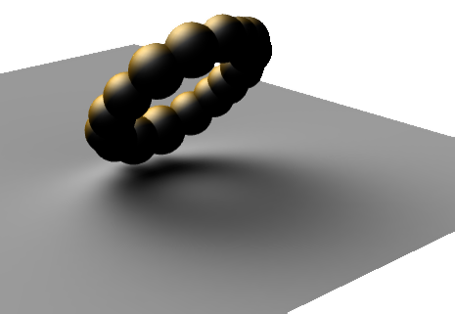
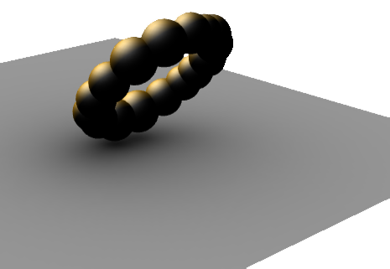
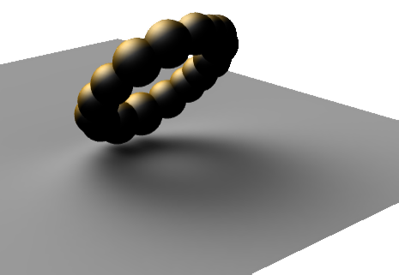
SHEXP vs. Ambient Occlusion
ray traced
ambient occlusion
[Bunnell04]
SHEXP
Notes:
Ambient occlusion in the lower left only provides a proximity cue.
Our method in the lower right , which we call spherical harmonic exponentiation, casts a shadow behind the object as it should.
Essentially, we extend the frequency range used to represent visibility from its average or DC component to higher frequencies to get shadows that can be cast.

Slide 7
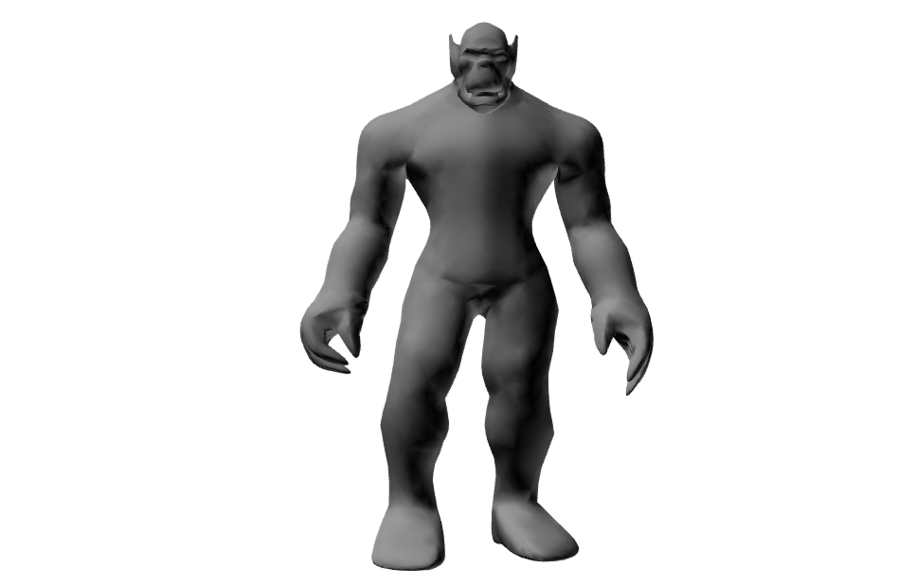
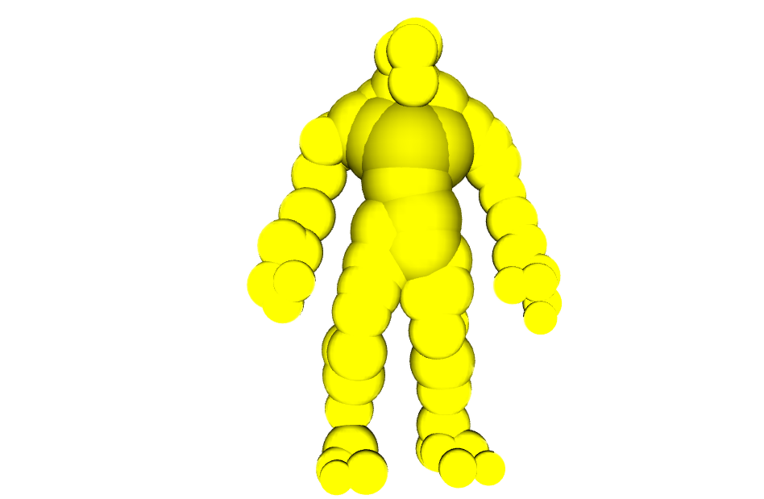
SHEXP Review
Approximate blockers with spheres
  accumulate over large blockers, not light directions
  symmetry simplifies calculation
Notes:
In a nutshell, our approach approximates blockers [click] as sets of spheres.
Accumulation over large blocking primitives is faster than accumulating over light directions.
The symmetry of spherical blocking primitives also simplifies the computation.

Slide 8
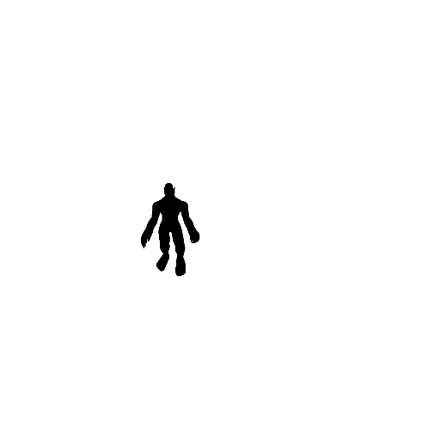

SHEXP Review
Approximate blockers with spheres
  accumulate over large blockers, not light directions
  symmetry simplifies calculation
Represent low-frequency visibility/lighting in SH
Notes:
We represent the visibility functions of these blockers as well as the lighting using their low-frequency components in the spherical harmonic basis.

Slide 9
SHEXP Review
Approximate blockers with spheres
  accumulate over large blockers, not light directions
  symmetry simplifies calculation
Represent low-frequency visibility/lighting in SH
For each receiver point p
  accumulate visibility logarithm over blocker spheres
  exponentiate
  shade
Notes:
For each receiver point p, we accumulate logarithms of the visibility function of all spheres blocking light incident on p.
Going to log space makes the computation much faster.
We then exponentiate the visibility function and compute the shade at p.
Conceptually this paper is the same, where it differs is how and where you accumulate the logs.

Slide 10
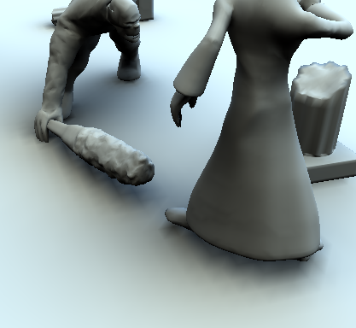

SHEXP Problems
Shading computed per-vertex
Visibility sampling rate coupled to shading
Receiver clustering/sphere hierarchies needed
Looping over blocker spheres bad for SIMD
vertex-based: 30fps
60767 vertices
image-based: 63fps
256×256 receiver buffer
Notes:
The principle problems with last years papers are that the computation is done per-vertex as shown in the image at the bottom left of the slide, the shading/sampling rates are coupled and there is a fair amount of complexity around the clustering/hiearchies that were needed for performance.
Most importantly the control flow that exists in the main shader (log accumulation) isn’t SIMD friendly.
Our new technique addresses these limitations.

Slide 11
Our Approach
Use feed-forward rendering model
  “splat” logs by rendering spheres
  loop implicitly via primitive stream
  sample in screen space
Exploit softness of GI effects
  render into a subsampled buffer
  upsample using bi-lateral filter
  decouple visibility sampling from shading
Notes:
To address these problems we moved to a feed forward rendering model. Instead of looping over spheres in pixel shaders, we “splat” inflated spheres in screen space and accumulate logs that way. This lofts the control flow out of the shader and into the primitive stream where it can be handled efficiently. This also does the rendering in screen space.
Shadows are smooth, so doing this at full resolution is overkill. Performance can be saved by computing visibility at a reduced resolution, and carefully upsampling when shading at screen resolution using a variant of bi-lateral filtering.

Slide 12
Sphere of Influence
p
p close to blocker = lots of shadowing
Notes:
Near contact a proxy sphere will have significant shadowing due to the large solid angle.

Slide 13
Sphere of Influence
p
p far from blocker = negligible shadowing
Notes:
This tapers off as it fades away – at some distance the occlusion becomes negligible.

Slide 14
Sphere of Influence
rule of thumb for 4th order SH: expansion factor η = 15
Notes:
We want to compute a radial expansion factor where this is “negligible” for a given SH order. We can do this by creating a simple analytic experiment, given the “peakiest” SH light (a directional light) and a surface normal looking directly into the light that reflects unit radiance when un-occluded, at what distance does a unit radius sphere need to be where the reflected light is epsilon from unit? For 4th order light a scale factor of 15 represents one gray level in an 8 bit display.

Slide 15
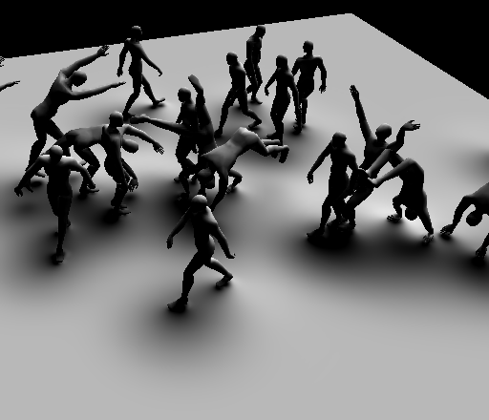
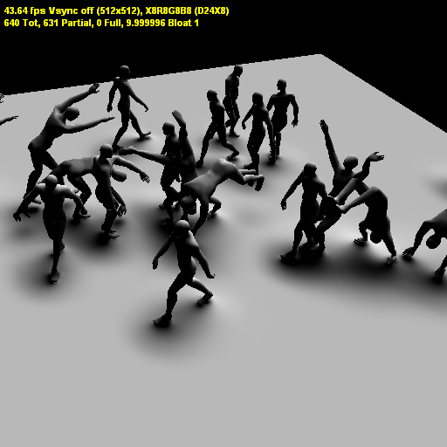
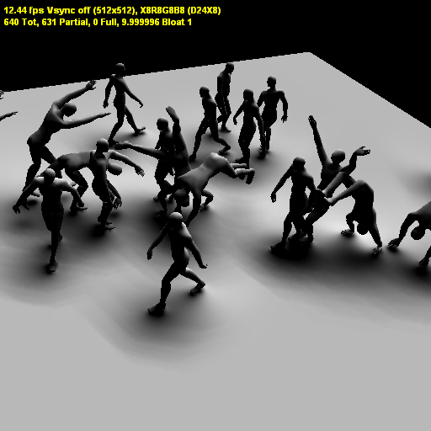
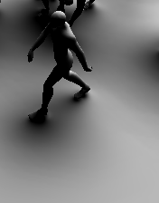
Shrinking the Sphere of Influence
η = 15
η = 10
clamping
no clamping
66 FPS
82 fps
78 fps
Notes:
The influene region can be shrunk, increasing the peformance but causing the shadows to not cast as far. [click] the logs need to be attenuated when this happens so that there aren’t visible artifacts at the boundary of the sphere of influence.

Slide 16
Splatting Proxies
Notes:
Here we see a simple scene, and the camera and screen.

Slide 17
Splatting Proxies
Notes:
Here is a proxy sphere, and it’s bloated influence region.

Slide 18
Splatting Proxies
Notes:
When this is rendered, it covers a portion of the screen where a shader is run (denoted in red.)

Slide 19
Splatting Proxies
Notes:
Only the green pixels pass the containment test, where significant work has to be done (computing the log).

Slide 20
Splatting Proxies
Notes:
Here is a smaller proxy that happens to have more pixels covered.

Slide 21
Splatting Proxies
Notes:
If the bloated proxy intersects the front clipping plane, the entire plane needs to be drawn to prevent rendering artifacts.

Slide 22
Upsampling
Notes:
Given a scene we first generate low resolution visibility samples [click] (colored based on the primitive here – we also store the surface normal (arrows) and depth.) Now we need to determine what is the influence of a given visibility sample on any point on the screen?
For these examples we are going to look at the influence of the 3rd pixel from the left [click]. An obvious choice is to use basis functions in screen space (as you get from texturing hardware), like the linear basis functions shown here [click].
This is fine with this scene, where all of the visibility functions are the same, however if we had another polygon [click] the visibility functions on the left include shadowing from the green polygon, so shouldn’t be blended with the ones on the right. This can be accommodated by looking at the differences in depths in this scenario, using this green basis function [click].
Another scenario is a crease [click], where nearby points have similar depths, but vdifferent normals, hence different visibility functions. Normal variation would effectively handle this case [click].
Those 3 basis functions can be combined using a variant of bi-lateral filtering. Taking a product of the three terms restricts you to interpolating visibility only when it agrees with all three constraints.

Slide 23
Bi-Lateral Upsampling
Notes:
Here is a slightly more complex scene, where the normal varies over the blocking polygon. Looking at the same pixel [click]

Slide 24
Bi-Lateral Upsampling
Notes:
There is a spatial component [click]

Slide 25
Bi-Lateral Upsampling
Notes:
a depth component [click]

Slide 26
Bi-Lateral Upsampling
Notes:
and a normal component [click].

Slide 27
Bi-Lateral Upsampling
middle pixel
left pixel
right pixel
Notes:
These are normalized resulting in the given influence function. [click] The neighboring pixels are shown for comparison.

Slide 28
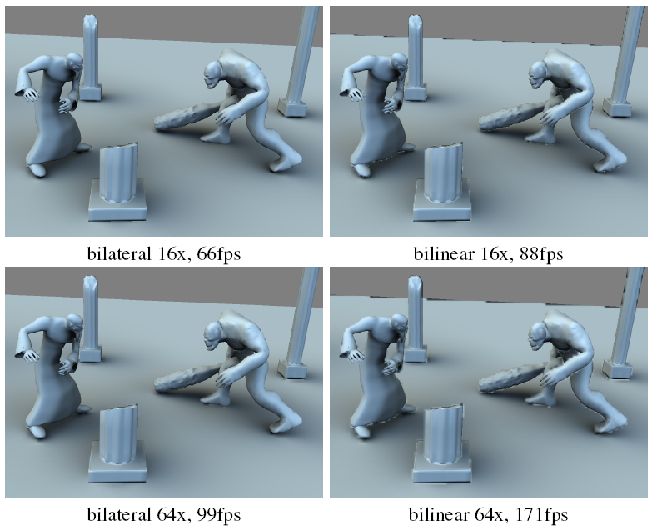
Comparison Images
Notes:
Here is an image comparing bilateral upsampling vs. naïve bilinear upsampling. The normals used for shading are from the mesh, just the visibility is interpolated from the low resolution image (quarter res on the top, 1/8th on the bottom, upsampled to 1024^2.)
Notice the poor quality of silhouettes in particular with bi-linear upsampling.

Slide 29
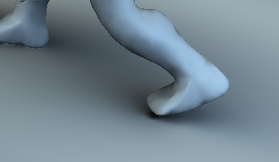
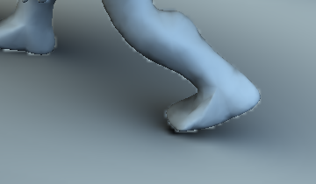


Comparison Images
Notes:
Here we zoom in on the back foot, to make the artifacts from bi-linear filtering of visibility more clear.

Slide 30
Indirect Lighting
L
Lighting reflected from proxy onto receiver
Assumptions:
  distant lighting L
Notes:
We are going to present a simple model of indirect lighting.
Given a proxy sphere, what is the lighting (arriving at a receiver point) that is reflected off the sphere?
[click]
The first assumption we are going to make is that the lighting is distant. Here is a crude proxy for an overcast day.

Slide 31
Indirect Lighting
Lighting reflected from proxy onto receiver
Assumptions:
  distant lighting
  diffuse/unshadowed proxy
Notes:
The next assumption is that the material is diffuse and lighting incident on the sphere is unshadowed. This means the lighting arriving at the receiver point will not depend on any frequencies of the distant lighting higher than the quadratic ones. An exact operator can be computed as a function of the solid angle subtended, but it too expensive (see details in the paper.) Note that the “yellow” portion would not be reflected onto this receiver point.

Slide 32
Indirect Lighting
Lighting reflected from proxy onto receiver
Assumptions:
  distant lighting
  diffuse/unshadowed proxy
  constant emission over proxy
    averaged over visible disk
Issues:
  average radiance?
  accumulation?
  overlap?
Notes:
The final assumption is that emission from the proxy is constant over its visible disk.
This makes the incident radiance easily evaluated using the convolution theorem.
[click] All that remains is how do we compute the average radiance, how do we accumulate incident radiance, and how do we account for overlapping spheres?

Slide 33
Averaging Indirect Radiance
receiver near proxy → sample single point
Notes:
The average radiance can be computed in closed form as a convolution. Near the proxy you just sample one point, so the kernel is a delta function.

Slide 34
Averaging Indirect Radiance
receiver near proxy → sample single point
receiver far from proxy → cosine weighting
Notes:
Far away from the proxy an entire hemisphere is visible, and due to nusselts analog, a cosine is the kernel.

Slide 35
Averaging Indirect Radiance
receiver near proxy → sample single point
receiver far from proxy → cosine weighting
general case →
  closed form for D
  approximate D via polynomials in sin(θ)
  Single quadratic SH evaluation in
θ
Notes:
The three convolution coefficients have analytic forms, but also are very smooth so they can be approximated with simple low order polynomials of the sin of theta. It is also worth pointing out that only a single quadratic SH evaluation needs to be done for this shader, in the direction –d (from the reciever to the sphere center) for both computing the average radiance and evaluating the incident radiance of a spherical light source.

Slide 36
Indirect Lighting
Accumulation
  splat with η =10
Overlap
  prevent unbounded accumulation
  normalize by:
Notes:
Accumulating the quadratic incident radiance vectors can be done the same way we accumulate logs, in screen space. A similar experiment indicates that an expansion factor of 10 seems appropriate.
[click]
Just doing this results in an over estimation of incident radiance if the proxy spheres overlap. While accumulating incident radiance, you can also accumulate the sum of the solid angle subtended by the spheres. The actual solid angle subtended has already been computed, it is a linear function of the DC visibility term. The ratio between it and the sum of solid angles is used to modulate incident radiance.

Slide 37
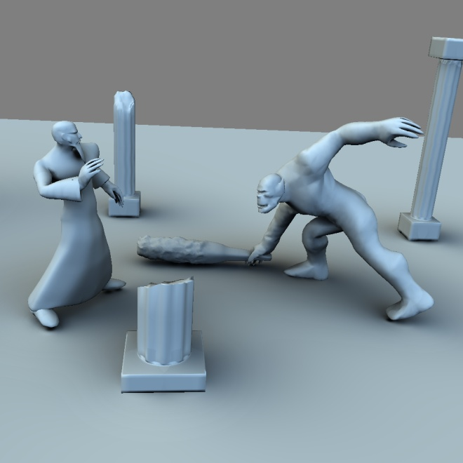
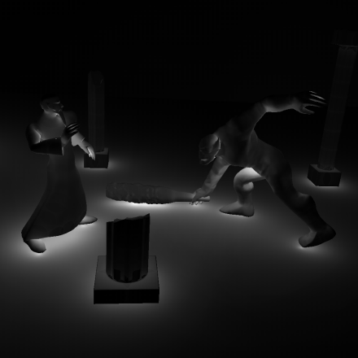
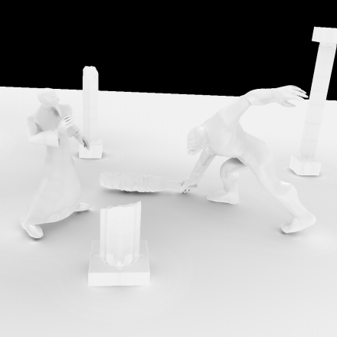
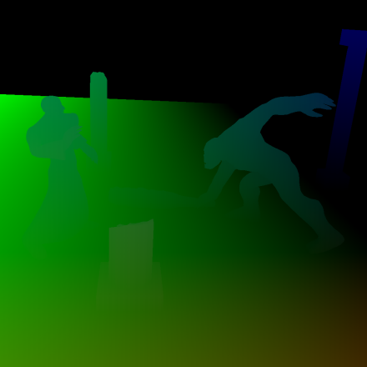
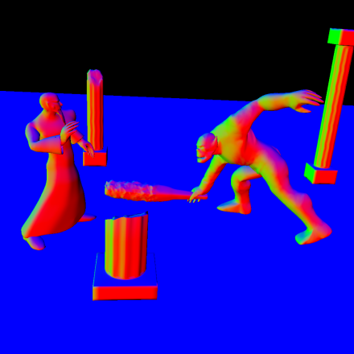
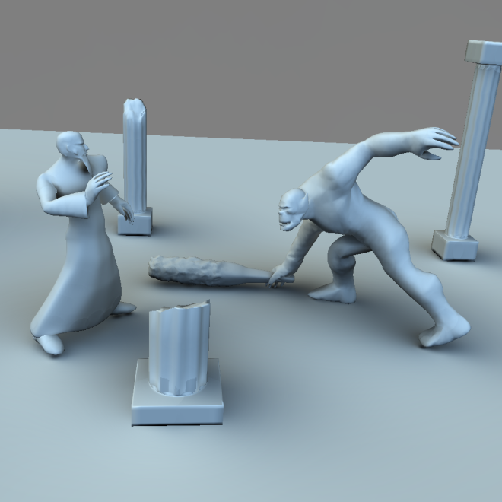
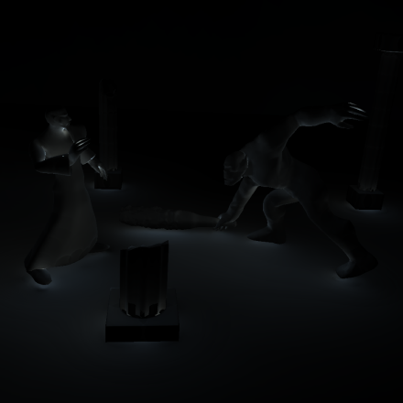
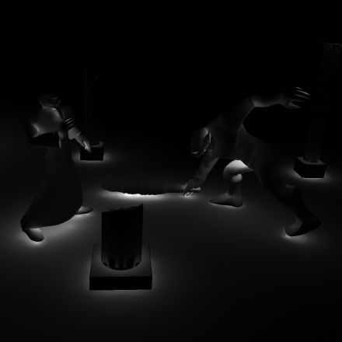
Pipeline
shadowed
66fps
shadowed + indirect
48fps
Notes:
We now walk through the algorithms.
You first compute low res buffers with the position and normal data of the scene. [click]
Then you accumulate the logs (visualized as there magnitudes) and [click] exponetiate them.
Finaly [click] you up-sample the visibility function and shade at screen resolution, generating the shadowed image.
[click] for indirect lighting you accumulate the incident radiance vectors [click] and sum of solid angles. [click] then upsample and add to get indirect lighting – note the softer look.

Slide 38
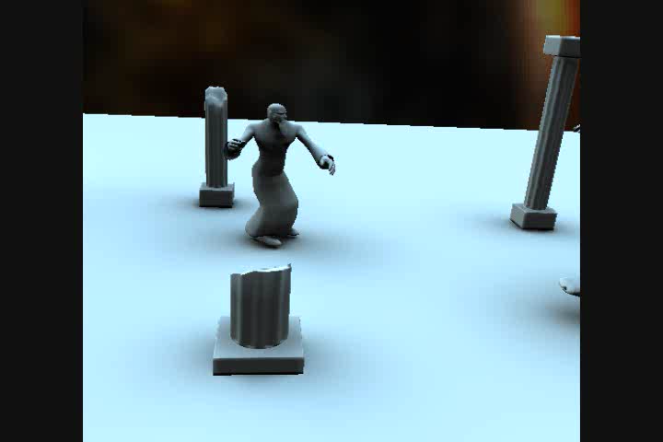
Video: Fight Scene
63 FPS
Notes:
Here we see a crapy video of the fight scene.

Slide 39
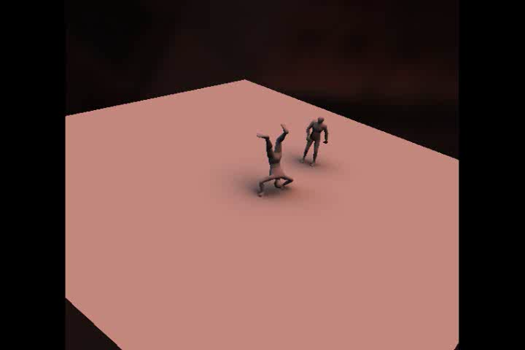
Video: Acrobats
55 FPS
Notes:
Here is a video of characters, it starts as 2 and becomes 20 by the end of the clip. This scene would have been extremely difficult using last years technique.

Slide 40
Limitations
low-frequency visibility & lighting
distant lighting
approximate indirect lighting
  single bounce
  gather: radiance over proxies unshadowed
  scatter: occlusion between proxies neglected
sampling not adaptive
Notes:
Our technique has several limitations, it is restricted to low-frequency, distant lighting.
The indirect lighting is also very approximate – only a single bounce is modeled, when gathering incident radiance at a proxy no shadowing is modeled and when reflecting it to reach a reciever the occlusion is handled in a very approximate way (normalization defined earlier.)
Finally the sampling should really be adaptive.

Slide 41
Conclusions
simpler, faster, better than SHEXP
includes approximate indirect lighting
future work:
  adaptive sampling
  gradient based reconstruction
  more accurate (but still fast!) indirect lighting
Notes:
To conclude this technique is simpler, faster and better (hiquer quality) compared to our previous work. It also includes approximate indirect lighting. In the future we would like to investigate efficient adaptive sampling on GPU’s, accumulating/reconstructing gradients of the visibility function and more accurate but still fast indirect lighting.

Slide 42
Thanks!

