Slide 1
Reduced Aggregate Scattering Operators for Path Tracing
s
Adrian Blumer
Jan Novák
Ralf Habel
Derek Nowrouzezahrai
Wojciech Jarosz
Notes:
Welcome everyone, my name is Adrian Blumer, and I am happy to present you the paper “…”. I’ve worked on this during an internship at Disney Research in Zurich together with a handful of amazing people, namely (..)

Slide 2
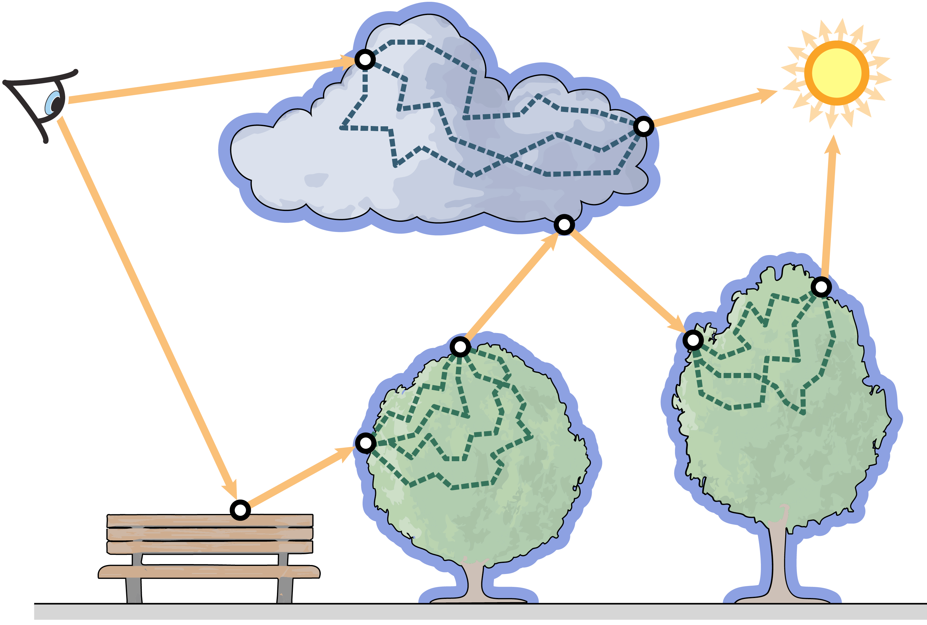
Overview
Reduced
Aggregate
Scattering Operators
for Path Tracing
Notes:
Looking at the paper name, let me give you an overview of the paper.
-------------------------------
First of all let’s start with the – at first glance – rather cryptic name of the paper: Reduced Aggregate Scattering Operators (RASOs in short) for path tracing.

Slide 3
Overview
Reduced
Aggregate
Scattering Operators
for Path Tracing
Notes:
We propose a technique to precompute scattering operators which represent the light transport within assets. Those assets could be clouds, trees or similar objects.

Slide 4
Overview
Reduced
Aggregate
Scattering Operators
for Path Tracing
Notes:
“Aggregate” emphasizes the fact that these operators capture the complete light transport through the respective asset. That includes multiple scattering events along a single light path path (for example a ray of light hitting a leaf in a tree, being reflected, hitting another leaf and so on). As well as the combination of all possible light paths through the asset between any two end points.

Slide 5
Overview
Reduced
Aggregate
Scattering Operators
for Path Tracing
Notes:
At this point it might be useful to mention that we store these Scattering Operators in matrix form. Using matrix operations to represent light transport is nothing new. One of our contributions is to show how we can efficiently leverage and sample this structure from the framework of a path tracer.

Slide 6
Overview
Reduced
Aggregate
Scattering Operators
for Path Tracing
Notes:
Lastly the light transport we try to capture is a very complex operation. In order to make the memory requirements for this task manageable, we apply lossy compression to it which is tailored both to the individual asset and the expected lighting scenarios.

Slide 7
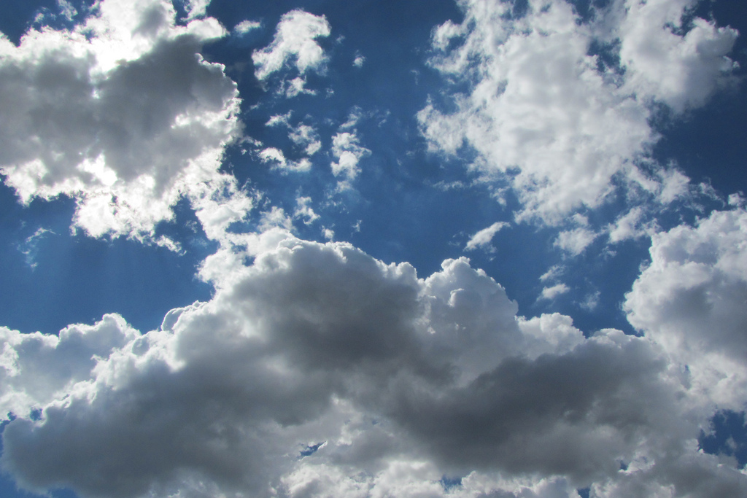
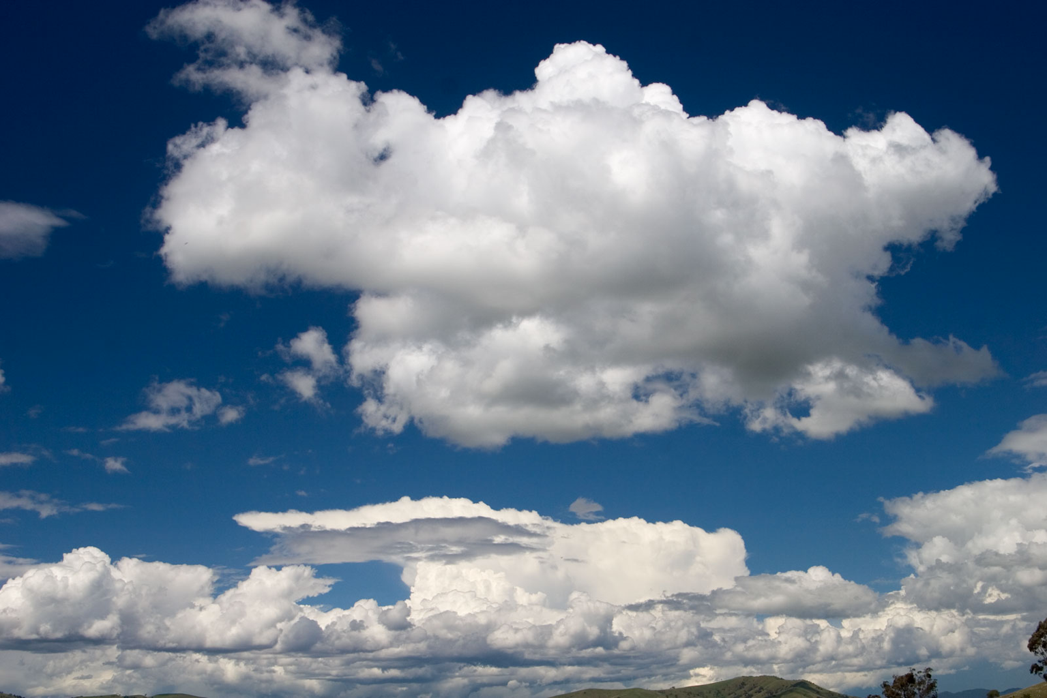
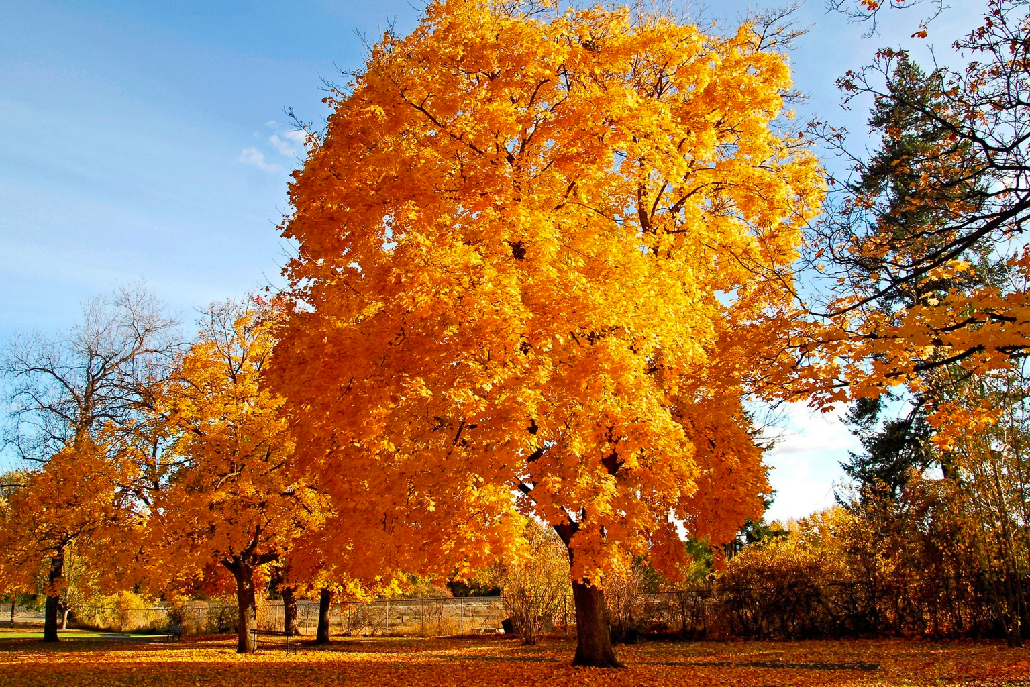
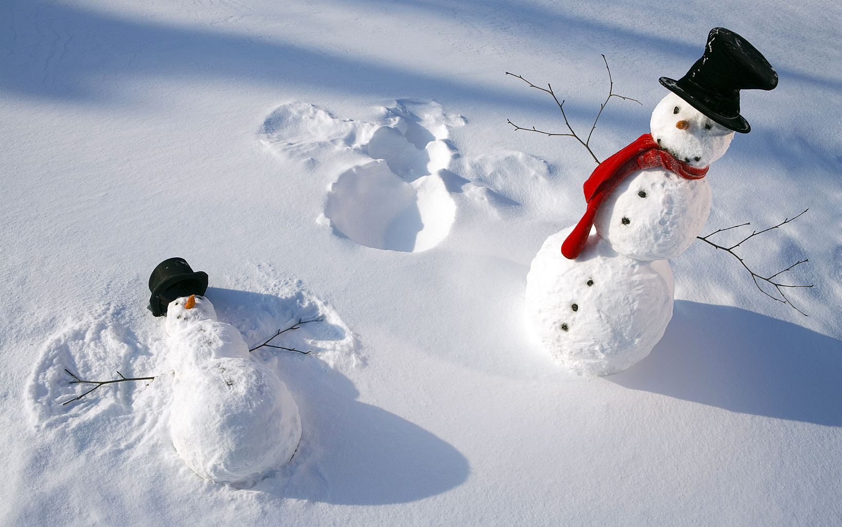
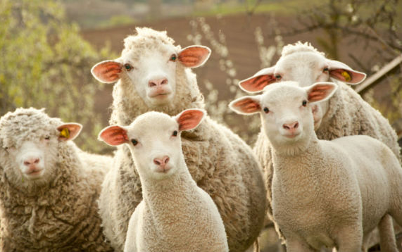
Motivation
image sources:
clouds: https://www.flickr.com/photos/rocor/608762581
tree: http://www.wallpapersonview.com/wallpapers/landscape_astonishing_nature_quality_trees_background_picture-2560x1600-12555.html
snowmen: http://funmozar.com/christmas-snow-wallpapers/
sheep: https://travelblog.expedia.co.th/westhern_thailand/15043/
Notes:
So when can this be used?
Generally speaking for self-contained assets where accurate light transport requires simulation of many, costly scattering events. So low absorption materials, objects with high geometric complexity, as well as participating media.
Ideally these assets are instantiated many times in the same scene and/or used repeatedly over time in multiple shots of an animation. The reason being that this helps to amortize the costly precomputation.

Slide 8
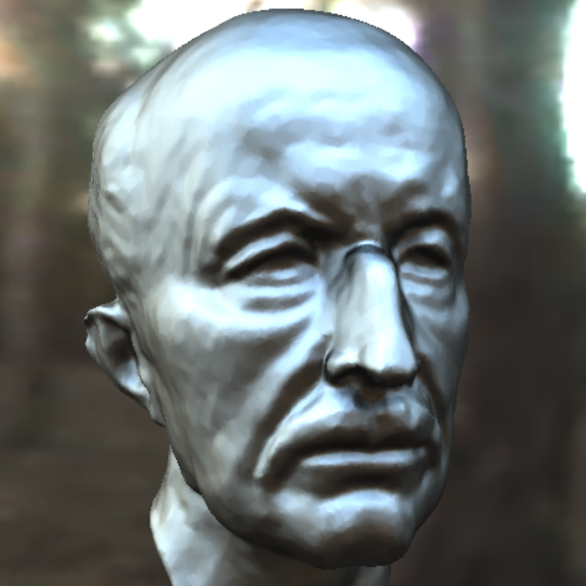
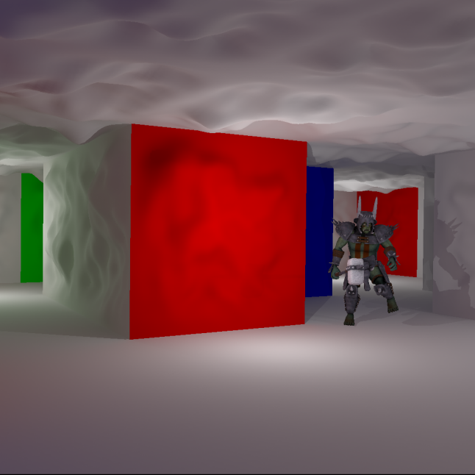
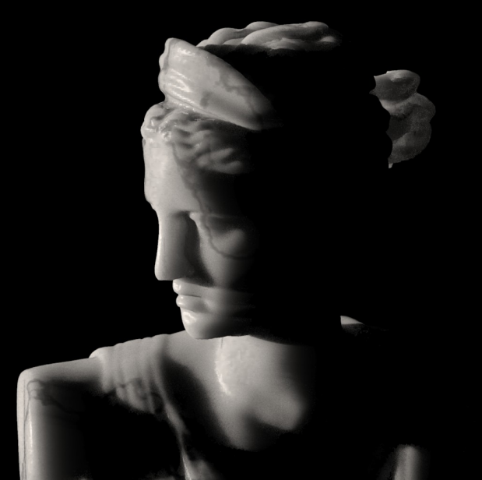
Selected Related Work
Clustered principal components for precomputed radiance transfer
Sloan et al., 2003
Modular radiance transfer
Loos et al., 2011
A Practical Model for Subsurface Light Transport
Henrik et al., 2001
Fast Monte Carlo algorithms for matrices I: Approximating matrix multiplication.
Drineas et al., 2006
Much more: importance sampling, caching of light transport, vegetation rendering, subsurface scattering, …
Notes:
Non on to a small selection from the vast landscape of related work.
I’ll give you small selection of especially relevant related work, even though the actual list is obviously much longer.
Sloan et al. introduced the idea of spatially clustering discretization elements to allow for better compression of transfer operators, a trick we’re also using in our approach.
Our method builds a lot on the work by Loos et al. on “Modular radiance transfer”.
We reuse the modularity idea, that is to precompute light transport for individual building blocks of a scene.
We also use their approach of a data-driven reduced basis, instead of the more commonly used analytical bases such as spherical harmonics.
Then there is “A Practical Model for Subsurface Light Transport” by Henrik et al. In this context our approach can be seen as a data-driven BSSRDF.
Lastly our technique can also be interpreted as approximating matrix vector products using Monte Carlo,
which is an active area of research outside of graphics. Drineas et al. give a good introduction to the topic.
Of course there’s lots of other related areas such as ….

Slide 9
Selected Related Work
Clustered principal components for precomputed radiance transfer
Sloan et al., 2003
Modular radiance transfer
Loos et al., 2011
A Practical Model for Subsurface Light Transport
Henrik et al., 2001
Much more: importance sampling, caching of light transport, vegetation rendering, subsurface scattering, …
Notes:
Non on to a small selection from the vast landscape of related work.
I’ll give you small selection of especially relevant related work, even though the actual list is obviously much longer.
Sloan et al. introduced the idea of spatially clustering discretization elements to allow for better compression of transfer operators, a trick we’re also using in our approach.
Our method builds a lot on the work by Loos et al. on “Modular radiance transfer”.
We reuse the modularity idea, that is to precompute light transport for individual building blocks of a scene.
We also use their approach of a data-driven reduced basis, instead of the more commonly used analytical bases such as spherical harmonics.
Then there is “A Practical Model for Subsurface Light Transport” by Henrik et al. In this context our approach can be seen as a data-driven BSSRDF.
Lastly our technique can also be interpreted as approximating matrix vector products using Monte Carlo,
which is an active area of research outside of graphics. Drineas et al. give a good introduction to the topic.
Of course there’s lots of other related areas such as ….

Slide 10
Precomputation
Path tracer integration
Notes:
And now let’s dive further into our method.

Slide 11
Precomputation
Path tracer integration

Slide 12
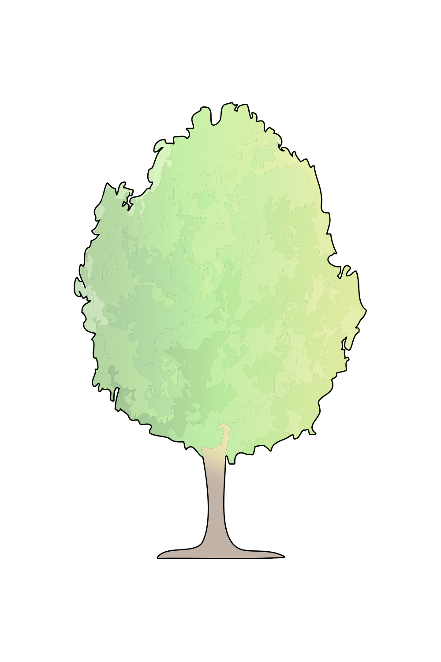
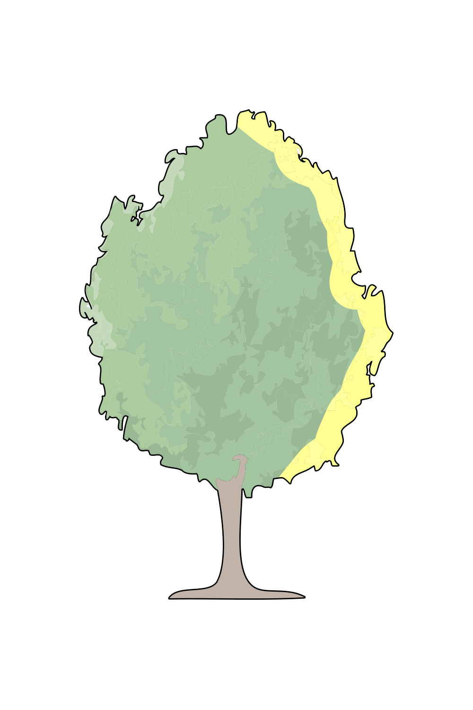


Method
indirect illumination
direct illumination
Light transport as a matrix operation
indirect
transport matrix
direct
=
×
Notes:
First of all let’s quickly introduce the concept of light transport as a matrix operation.
Given a discretization of our asset, we can represent illumination on it using a long vector of radiometric quantities per discretization element. This could for example be an irradiance value for each vertex of the asset.
We can use this representation for both direct and indirect illumination on the asset. And what stands in between them is a square transport matrix where each individual entry represents how direct lighting on one vertex influences indirect lighting on one other vertex.
Now the problem with this, is that the size of this transport matrix becomes unwieldy very quickly as the number of discretization elements increases.

Slide 13
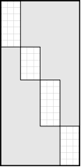

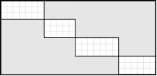
Method
indirect illumination
direct illumination
Light transport as a matrix operation
indirect
basis transform
transport
basis transform
direct
=
×
×
×
Notes:
So what we need to do is factorize the transport into multiple components. This is already very specific but in our case this includes a basis transform that appies lossy compression to the input signal. Then we apply transport in this reduced complexity space and into a different reduced basis space. Lastly we reconstruct indirect illumination from the reduced space.
Now we’ll look at how we construct these basis transforms.

Slide 14
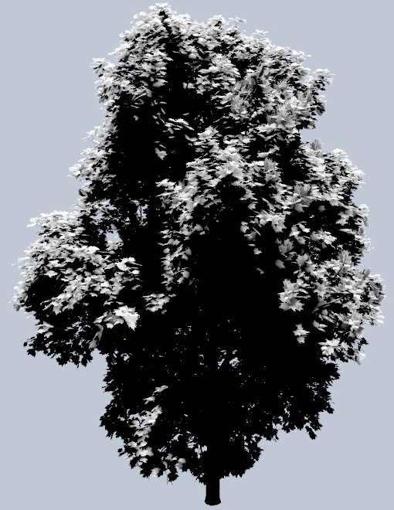
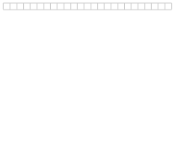
Method
Learning reduced bases
# of vertices
configuration 1
Modular radiance transfer
Loos et al., 2011
Notes:
We want the compression to be specifically tailored to both the asset and the lighting conditions we expect.
For this we light the our asset with different lighting scenarios. In this example with directional lights from different directions.
For each scenario we record the resulting direct illumination on the asset in rows of a matrix
Like this.

Slide 15
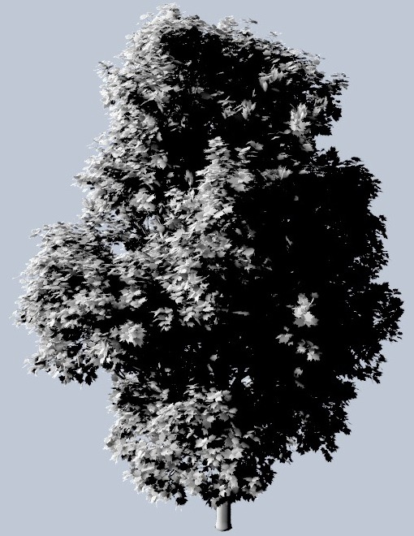

Method
Learning reduced bases
# of vertices
configuration 1
configuration 2
Modular radiance transfer
Loos et al., 2011
Notes:
And this.

Slide 16
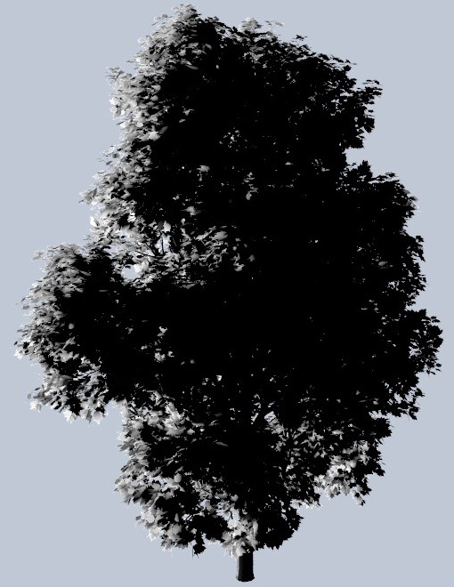

Method
Learning reduced bases
# of vertices
configuration 1
configuration 2
...
Modular radiance transfer
Loos et al., 2011

Slide 17
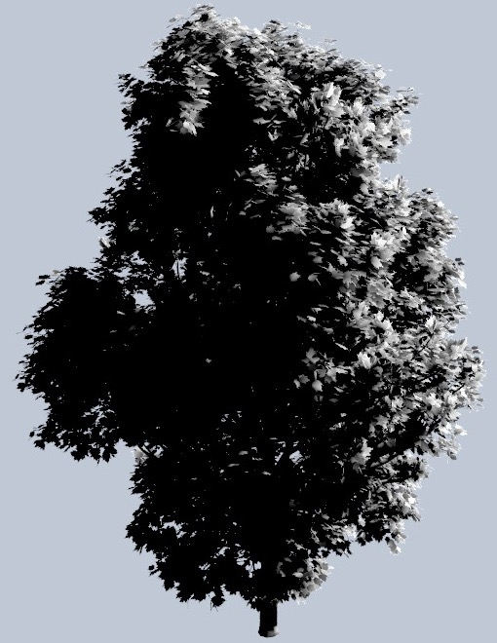

Method
Learning reduced bases
# of vertices
configuration 1
configuration 2
...
...
Modular radiance transfer
Loos et al., 2011

Slide 18
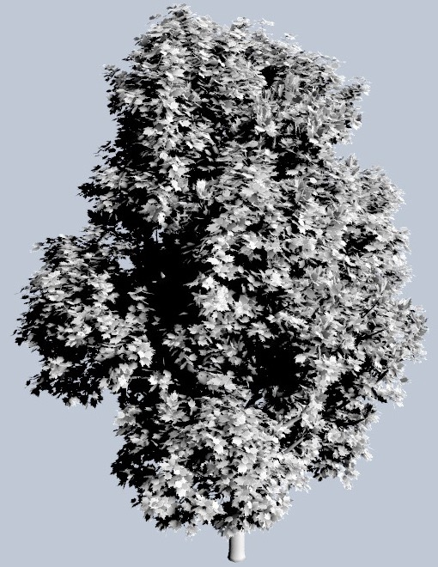

Method
Learning reduced bases
# of vertices
configuration 1
configuration 2
...
...
...
Modular radiance transfer
Loos et al., 2011

Slide 19
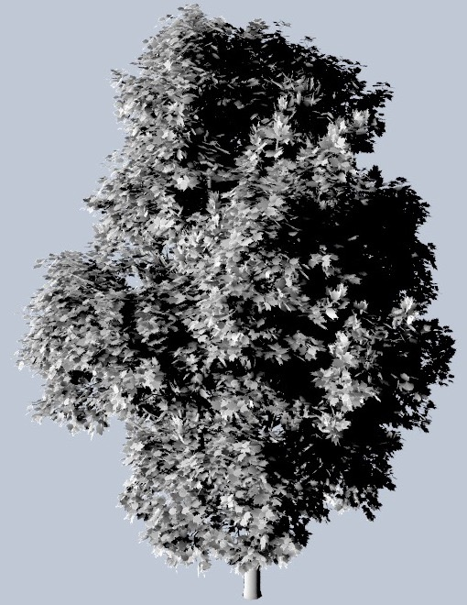

Method
Learning reduced bases
# of vertices
# of configuarions
Modular radiance transfer
Loos et al., 2011
Notes:
In the end we have a relatively large matrix representing observations of plausible lighting on the asset.

Slide 20
Method
Learning reduced bases
# of vertices
Compress using SVD
+
truncate
# of configurations
Modular radiance transfer
Loos et al., 2011
Notes:
Now we apply a Singular Value Decompositon (SVD) on the matrix. What the SVD does is it extracts the most contributing signals in the learning set and orders them by contribution.
This allows us to truncate the matrix, removing the least contributing basis functions while introducing minimal error.

Slide 21
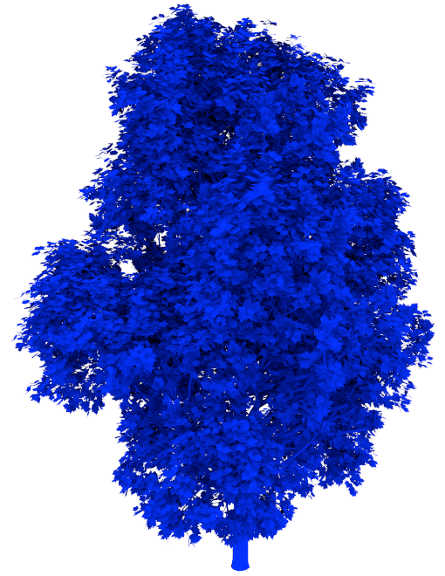
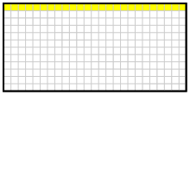
Method
Learning reduced bases
# of vertices
# of basis functions
compact basis
Modular radiance transfer
Loos et al., 2011
Notes:
We can visualize these basis functions on the asset and in practice it looks like this. The most contributing term is an ambient occlusion like function over the surface of the tree.

Slide 22
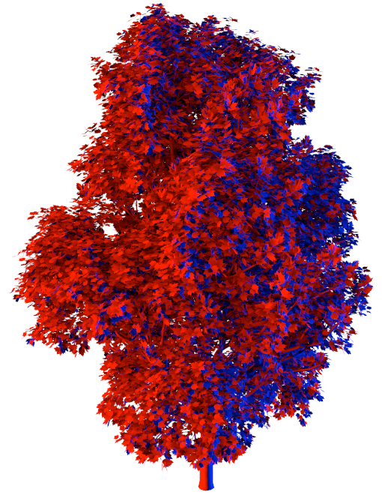
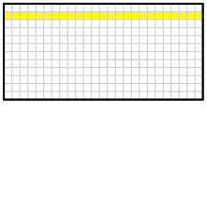
Method
Learning reduced bases
# of vertices
# of basis functions
compact basis
Modular radiance transfer
Loos et al., 2011
Notes:
The next band might differentiate between lighting from the left and the right. Note that the two colors represent positive and negative signals respectively.

Slide 23
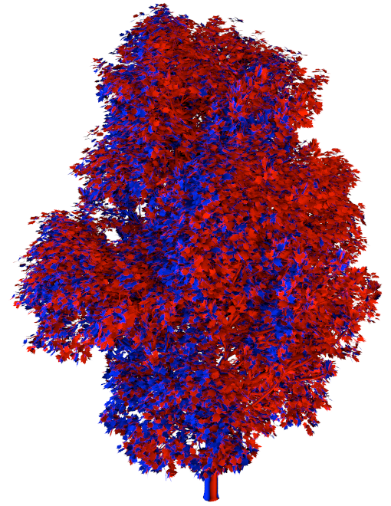
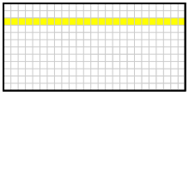
Method
Learning reduced bases
# of vertices
# of basis functions
compact basis
Modular radiance transfer
Loos et al., 2011
Notes:
If we continue down, we get different directionality and increasingly high frequency signals.

Slide 24
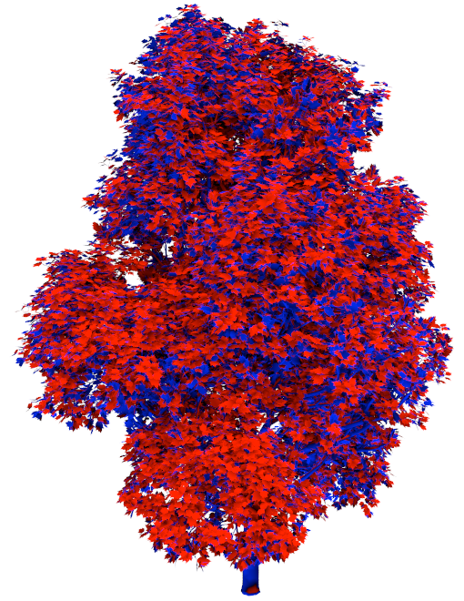
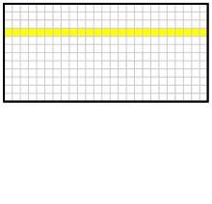
Method
Learning reduced bases
# of vertices
# of basis functions
compact basis
Modular radiance transfer
Loos et al., 2011
Notes:
Using this we get nice basis functions, but they all have global support.

Slide 25
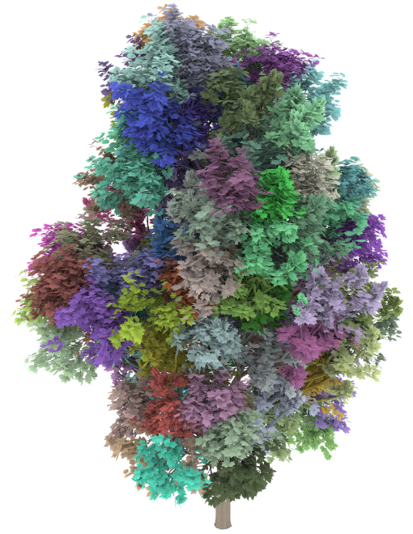
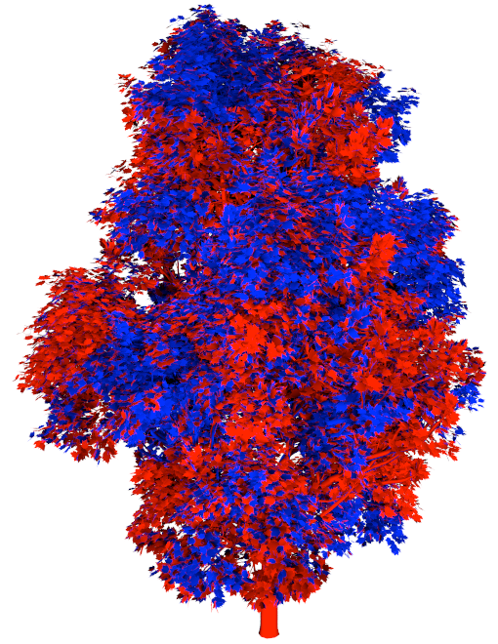
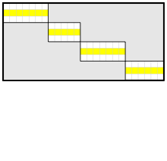
Method
Learning reduced bases
# of vertices
# of basis functions
clustered compact basis
Clustered principal components for precomputed radiance transfer
Sloan et al. 2003
Notes:
This is where spatial clustering comes into play. While the SVD favors signals with global support, this measure helps to support localized signals.
Consequently, each of the basis functions has only local support on a specific cluster, making the resulting matrix sparse, and thus more compact to store.

Slide 26
Method
indirect illumination
direct illumination
Learning reduced bases
indirect
indirect basis transform
transport
direct basis transform
basis transform
direct
=
×
×
×
Notes:
Now let’s skip ahead a little bit.
The process just described gives us the direct basis on the right
We repeat the same process recording indirect lighting on the asset to get the indirect basis on the left.
Using path tracing we can evaluate and record the transport between the two basis spaces, which gives us the transport matrix in the center.
Now given a full configuration of direct light on the asset, we can multiply it trough this, and get an approximation of the indirect lighting on the complete asset due to internal scattering.
This is what we describe as all-to-all transport in the paper.

Slide 27
Method
indirect illumination
direct illumination
Learning reduced bases
compact intermediate results
indirect
indirect basis transform
transport
direct basis transform
direct
=
×
×
×
Notes:
And as a side note a very useful side effect of this is that the intermediate results we have here, can be stored extremely compactly. This will become useful later on.

Slide 28
Precomputation
Path tracer integration
Notes:
So how can this be used in a path tracer?

Slide 29
Path tracer integration
Monte Carlo evaluation
Notes:
For a proper path tracing integration we need two things:
- once we hit the asset, a proper way to randomly sample a vertex on the asset to continue tracing from
a way to compute the transport
For now we’ll content ourselves with simply picking a vertex uniformly at random for the sampling part.
We can evaluate the incoming direct light at that vertex and transport it trough our matrices.
Because this is only one-to-one transport, we only need to access a very limited and clearly defined subset of our matrices.
This works, however transporting the contribution of every single ray cast through these matrices still proves to be a little costly in practice.

Slide 30
Path tracer integration
batching and caching
direct illumination cache
Notes:
This is why we introduce batches and caching
A batch in our case is casting one ray per image pixel. Within a batch whenever we sample incoming illumination we add it to an direct illumination cache here.

Slide 31
Path tracer integration
batching and caching
direct illumination cache
Notes:
And here

Slide 32
Path tracer integration
batching and caching
direct illumination cache
Notes:
All these samples are summed up in the cache.

Slide 33
Path tracer integration
batching and caching
indirect illumination
cache
direct illumination cache
between batches, apply transport
Notes:
Then between batches, we apply the transport at the end of a batch.

Slide 34
Path tracer integration
batching and caching
indirect illumination
cache
direct illumination cache
Notes:
Then when we are interested in the indirect illumination at a vertex, we simply look up the cache.
This approach allows us to amortize the transport computation over many samples.
There’s a more important benefit though.
In normal path tracing, each incoming sample would only contribute to a single image pixel in the image. Instead thanks to the intermediate caching, each incoming light sample contributes to all pixels in the image.
Significantly reducing noise.

Slide 35
Path tracer integration
Importance caching and sampling
Notes:
Now let’s look at the sampling part.
So far we’re picking the vertices to sample incoming light uniformly at random.
So if were interested in indirect light at the blue vertex, we’re just as likely to sample direct light at the red vertex as at the green one.
Now we would like to do importance sampling, that is we sample vertices relative to their contribution. An the green vertex is much more likely to contribute to the blue one than the red is due to their distance.
So how do we include this in our sampling process?

Slide 36
Path tracer integration
Importance caching and sampling
Importance cache
Notes:
Similar to our illumination caches, we introduce importance caches.

Slide 37
Path tracer integration
Importance caching and sampling
Importance cache
Notes:
Where every time a ray from the camera hits our asset we deposit “importance”, meaning that outgoing illumination at this point is important to the image pixels.

Slide 38
Path tracer integration
Importance caching and sampling
Importance cache
sampling weights
between batches, apply transport
Notes:
And again between samples we transport the importance

Slide 39
Path tracer integration
Importance caching and sampling
sampling weights
Notes:
Then, whenever we want to sample a direct vertex, we first importance sample a cluster

Slide 40
Path tracer integration
Importance caching and sampling
sampling weights
Notes:
and then within the cluster a vertex.
By doing this we can effectively importance sample both the transport through the matrices, as well as the contribution to the final image.
Again reducing variance.
For details on this sampling process I have to refer you to the paper, because now we continue…

Slide 41
Results
Notes:
with the results.

Slide 42
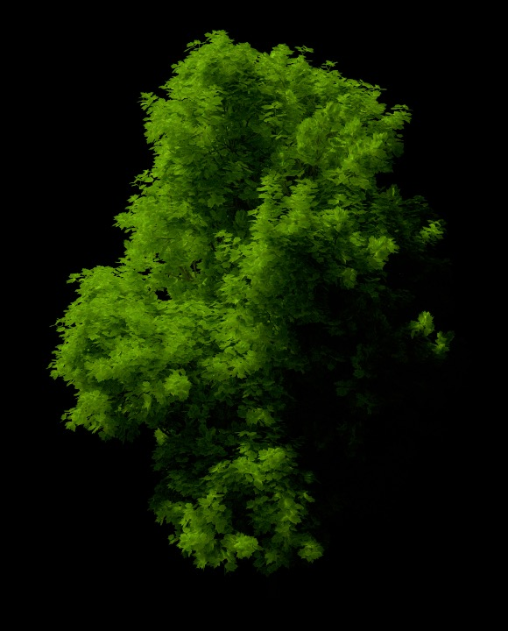
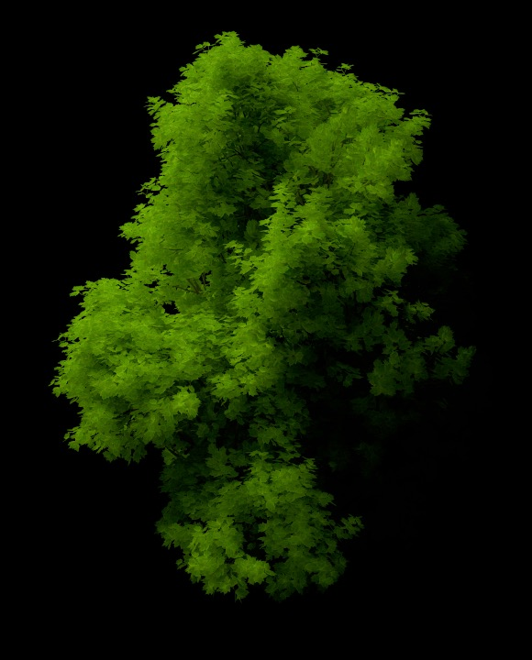
Quality
Path tracing
Path tracing with RASO
Side lighting
(in the training set)
*indirect illumination only
Notes:
In the following we compare the render quality of our approach to plain path tracing.
You can see that we loose some high frequency detail due to the transport truncation. This can also lead to washed out regions.
In this example actual lighting corresponds to one we used in the training scenario. So we can actually be sure that any bias introduced is due to the compression.

Slide 43
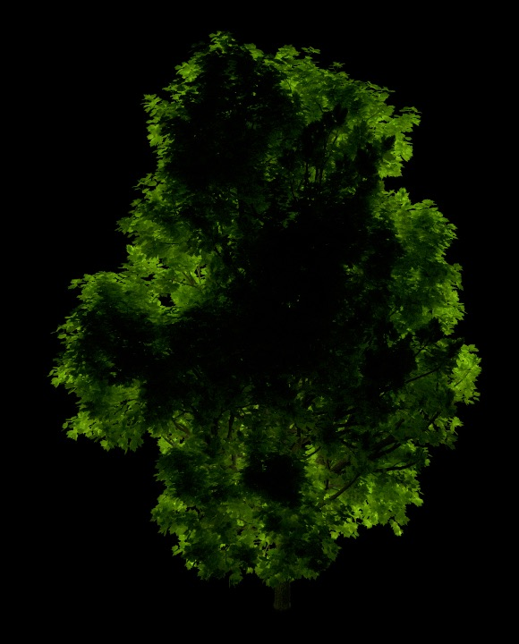
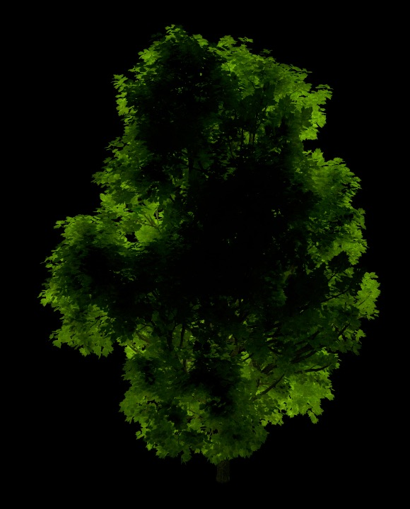
Quality
Path tracing
Path tracing with RASO
Back-lighting
(not in the training set)
*indirect illumination only
Notes:
This example show a lighting scenario that was not used in the training. Still our method handles it well.

Slide 44
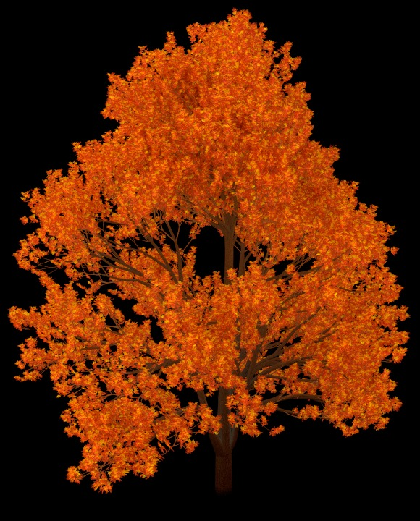

Quality
Path tracing
Path tracing with RASO
Ambient sky
(not in the training set)
*indirect illumination only
Notes:
Ambient lighting is very low frequency and thus a particularly easy scenario for our method to handle.

Slide 45
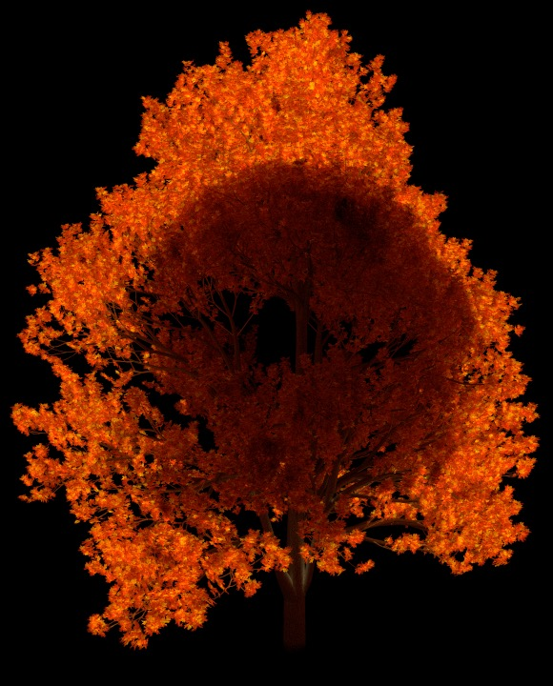
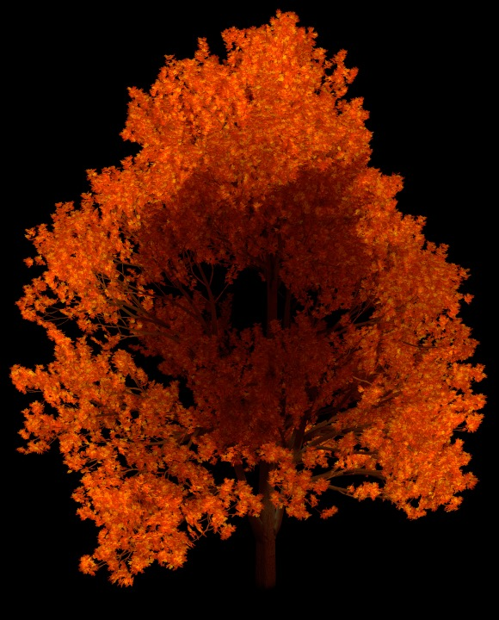
Quality
Path tracing
Path tracing with RASO
Front-lighting with occluder
(not in the training set)
*indirect illumination only
Notes:
Introducing an occlude is a more difficult scenario.
This creates a very high frequency signal which is more difficult for our method to handle, still especially the clustering helps a lot here.

Slide 46
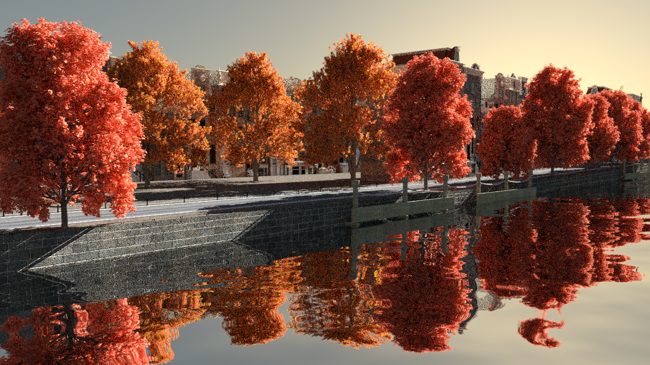



Performance
Equal-time Path tracing
Notes:
On the next two slides we compare a fully rendered scene including direct lighting using simple path tracing to path tracing with our RASOs.
This is the path tracing image using 37 samples per pixel.

Slide 47
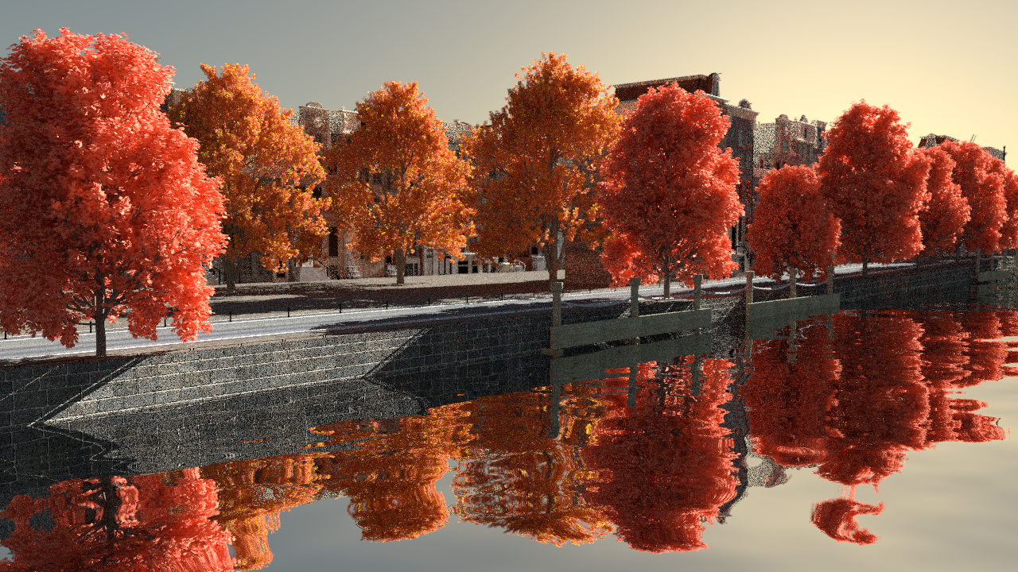



Performance
Equal-time Path tracing with RASOs (ours)
Notes:
And this is our result using 32 samples per pixel. Note that due to the caching and sampling overhead we can compute a little fewer samples in the same time window.
Still thanks to sample reuse we can significantly reduce the resulting noise.

Slide 48
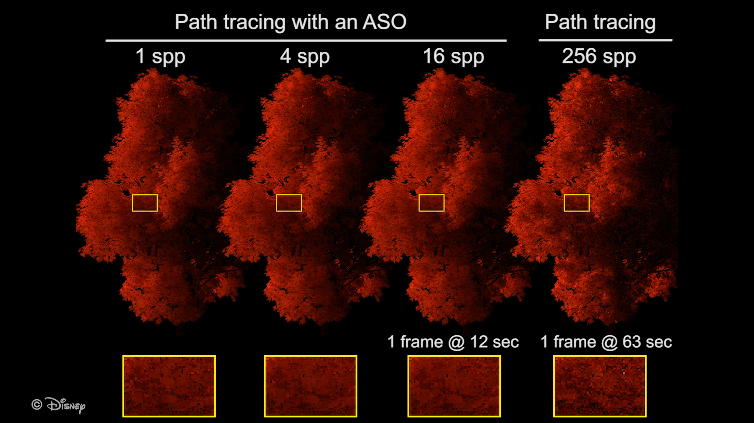
Temporal stability
TODO: video?
Notes:
Here we see two things:
@16spp the RASO implementation is perceptually temporally stable, while path tracing after 5 times as much time still shows strong high frequency flickering
----------------------------------
Another observation is that RASO @1spp produces already quality that might be sufficient for still frame preview shots
With our method, variance error quickly diminishes to where it is dominated by bias error, that is error induced by our approximations.

Slide 49
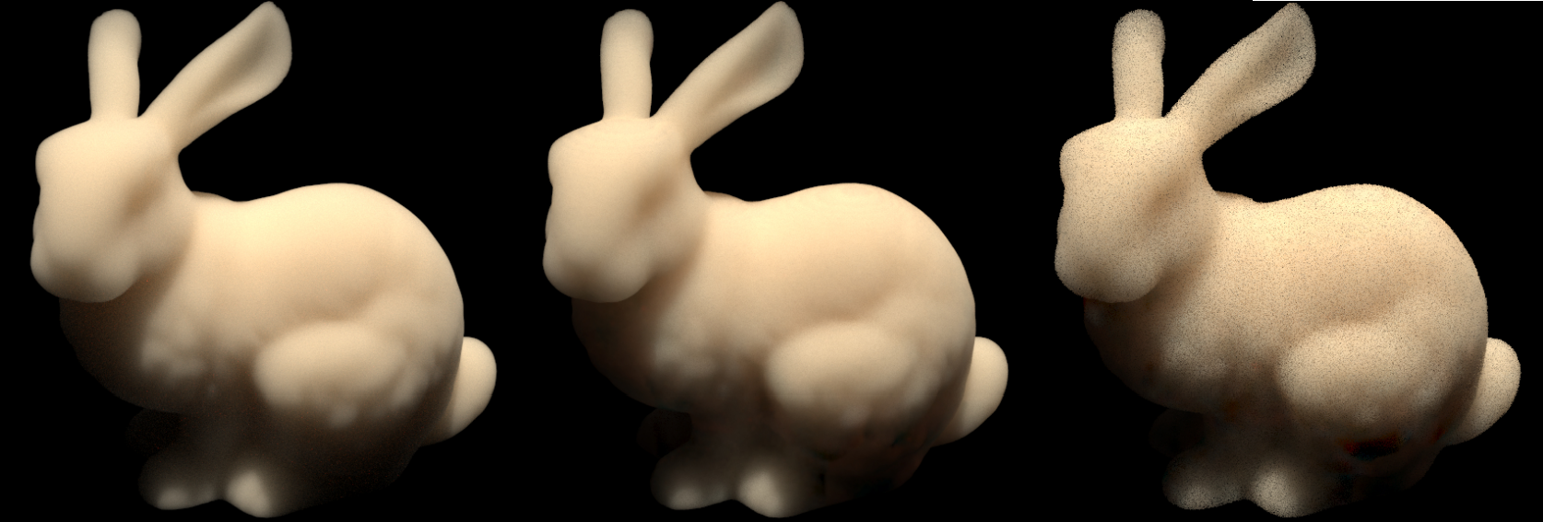
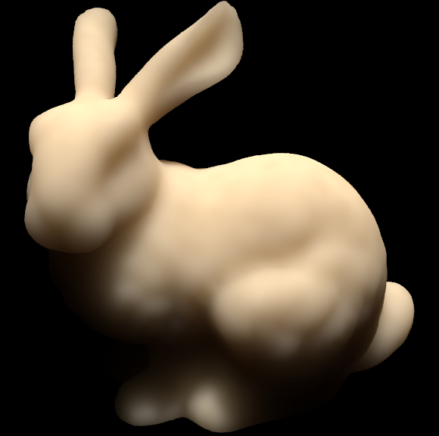
Homogeneous volume
PT
PT with RASO
PT with RASO
Diffusion dipole
(17 min)
(3.1 min)
(6 s)
(6 s)
multiple-scattering only, discretization: 128³ voxel grid,
dipole parameters hand-tweaked for visually similar result
Notes:
Lastly a small example of how our technique can be applied to participating media transport.
On the left we compare plain path tracing to path tracing with our transport operators.
The result is visually comparable and provides significant speedup.
On the right we compare our transport operators to the diffusion dipole.
After the same time we are not as noise free as the diffusion dipole.
The dipole however required hand-tweaked parameters for a visually similar result and still show over darkening in unlit areas.

Slide 50
Conclusion
Advantages
  - fast convergence
  - perceptually unobtrusive error
  - temporal stability
Limitations
  - precomputation & storage
  - bias
Notes:
Now to wrap things up:
We present a technique that offers significant performance gains for the computation of asset internal light transport.
Our method reduces variance at the cost of introducing noticeable but visually very unobtrusive bias.
Important for animations, the bias error introduced is temporarily stable, in contrast to variance which will show it self as flicker in consecutive frames.
Limitations of our technique include significant precomputation times combined with storage requirements in the hundreds of MB per asset.
The precomputation times are at least partially due to our currently highly unoptimized implementation and could be significantly improved
in a production scenario. As for the storage cost, we are confident that as long as it is shared between many instances of the same asset this is still justifiable.
Then there’s the bias introduced in our method. It can be categorized into error due to:
discretization
the limited learning set
basis truncation
stochastic training
Still depending on the application, these might be well acceptable considering the performance gains.

Slide 51
Future Work
- All-frequency Transport
- Application to Clouds
- Non-negative matrix factorization
Notes:
We also have a couple of routes for future work in mind:
One is an extension to all-frequency transport. Currently we only consider un-directional radiometric quantities (irradiance and fluence) at the entry and exit points of the asset.
One could consider the use of spherical harmonics or similar to retain some of the directionality of the input and output signals. Then again this would probably further increase memory requirements.
Clouds are a prime use-case for our RASOs as their appearance is highly dependent on the multiple-scattering within them.
Some early investigation from our side however showed that we would need adaptive discretization of the cloud volume to properly handle fine cloud boundaries.
Lastly, the bases generated through the SVD have many advantages but also one big disadvantage. The disadvantage being that the basis vectors have negative contributions which makes importance
sampling significantly more difficult. In the future it would be interesting to explore non-negative matrix factorization techniques to work around this.

Slide 52
Thanks for your time!
Questions?

