Slide 1
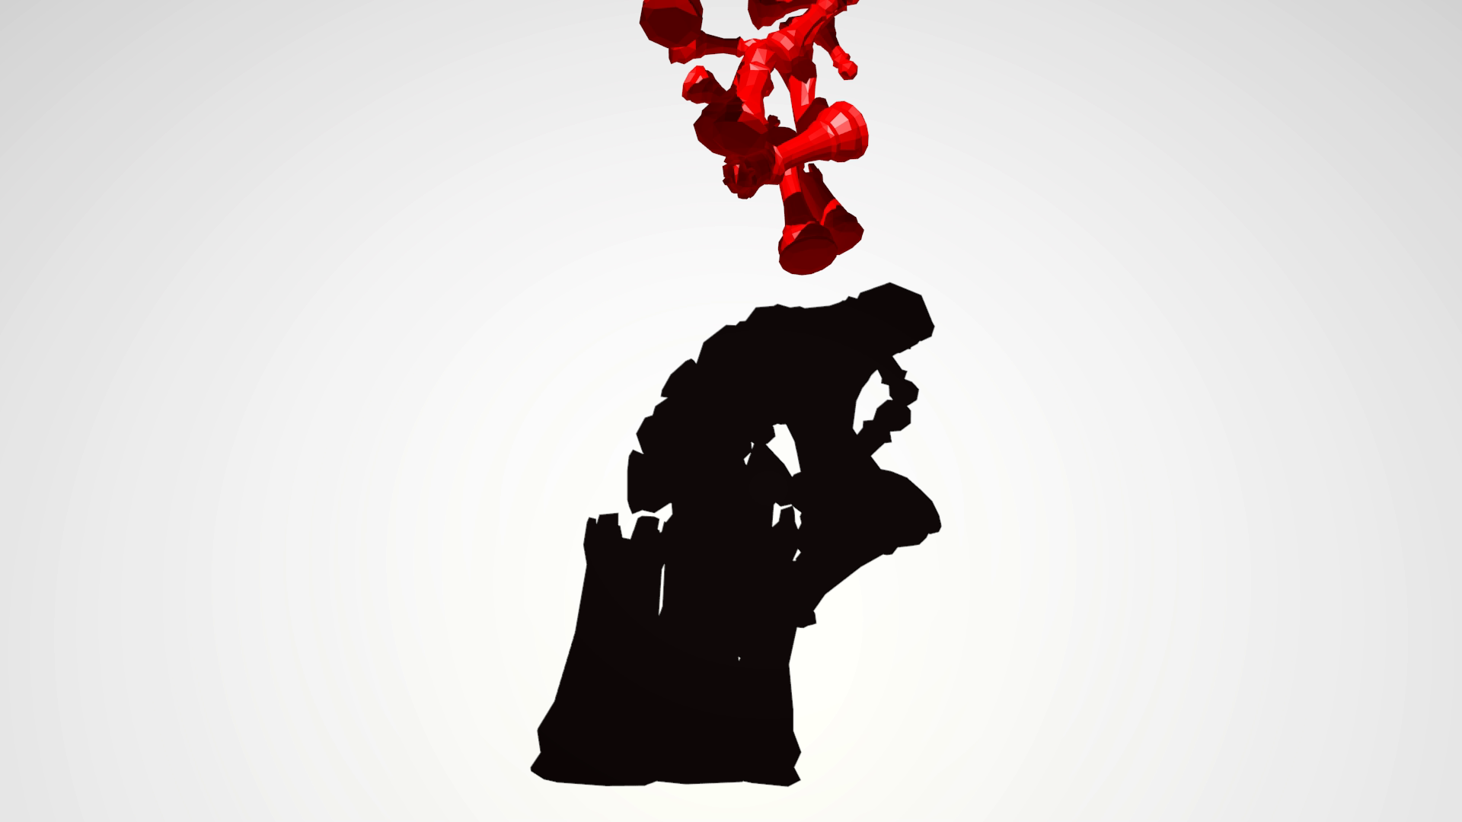


Ballistic Shadow Art
Xiaozhong Chen, Sheldon Andrews, Derek Nowrouzezahrai, Paul G. Kry
McGill University

Slide 2
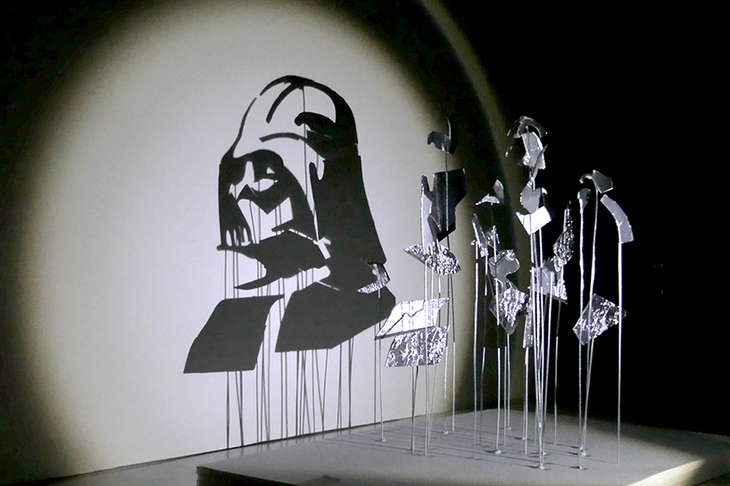
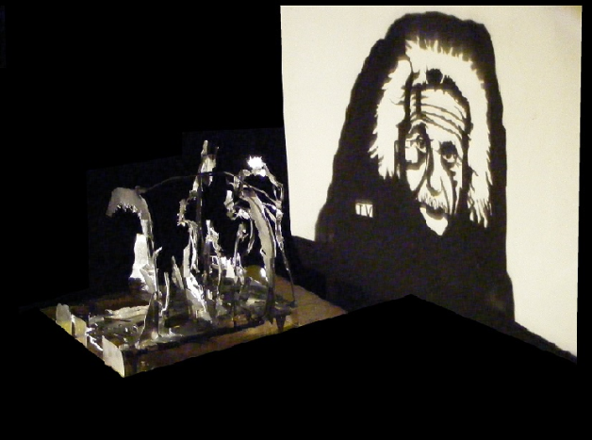
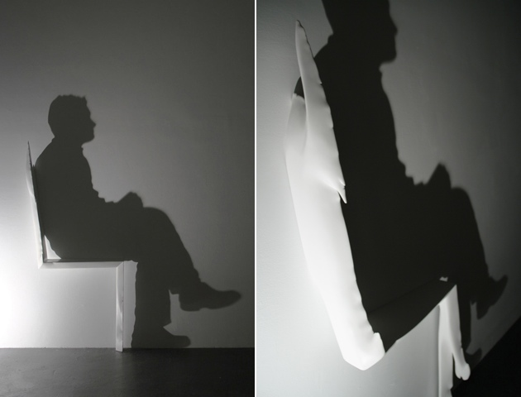
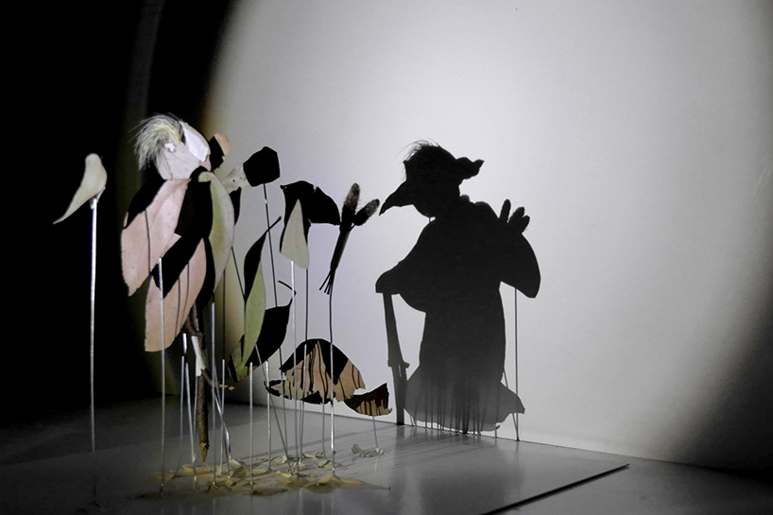
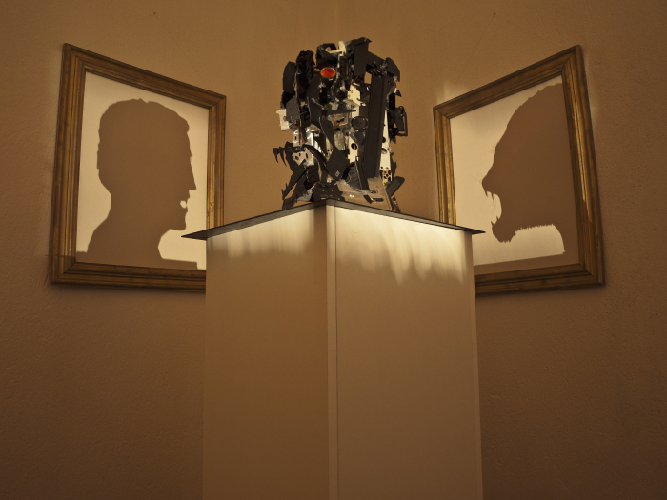
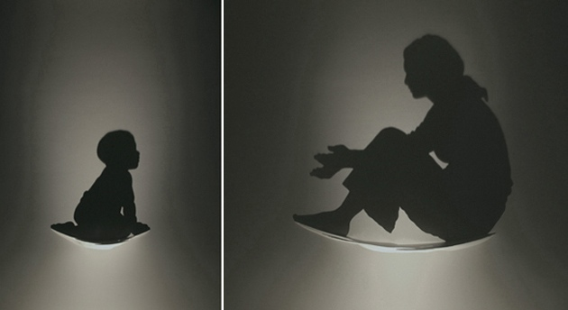
Shadow art
Red Hong Yi
Triantafyllos Vaitsis
Kumi Yamashita
Notes:
Shadow art in museums; shadow puppetry as a child
Seemingly unstructured collection of objects
Light shines from just the right direction, it becomes meaningful

Slide 3
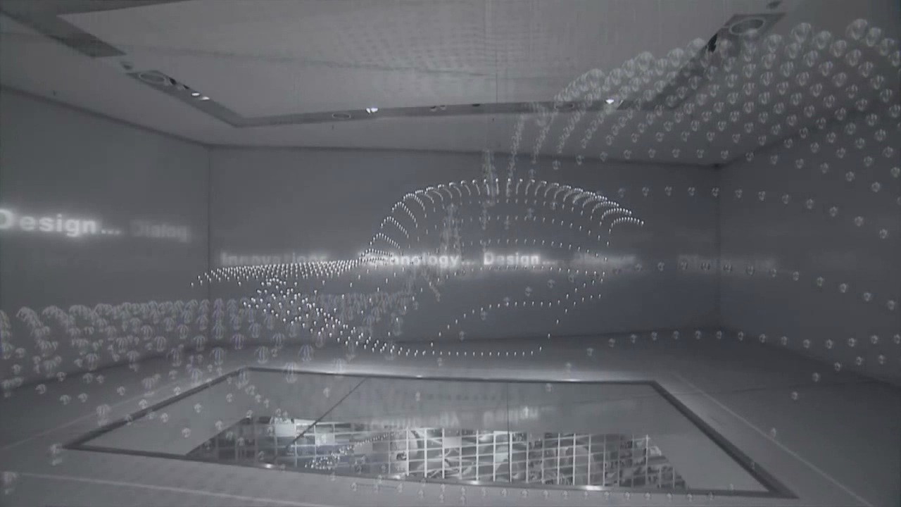
Kinetic sculpture
ART+COM Studios (2008)
Notes:
Installation at the BMW Museum in Munich.
We are fascinated by the intricate patterns, coordinated and complex motion of the objects.

Slide 4

Ballistic Shadow Art
Generate ephemeral shadow art with objects involved in ballistic motion
Combines aspects of kinetic sculpture and shadow art
Semi-automatic framework involving a stochastic optimization and multi-body physics simulation with contact
Notes:
Optimization is harder than it look!
Imagine taking some balls, throwing them in the air, and hoping to create the “Mickey” shadow shown here.

Slide 5
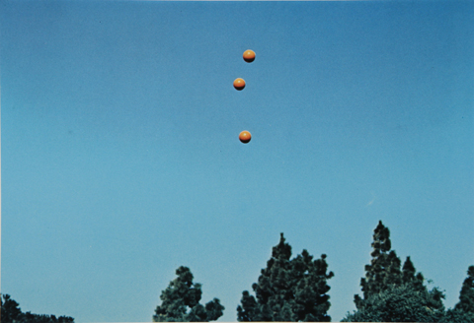
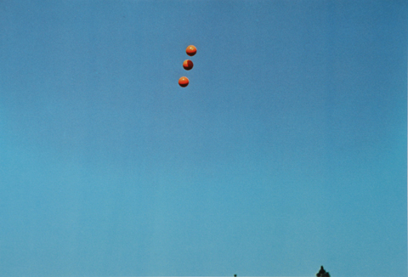
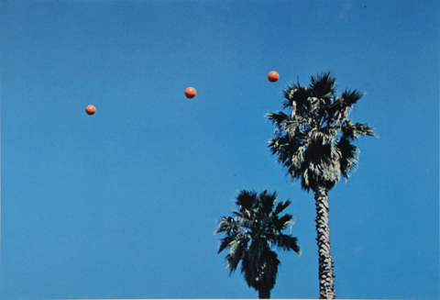
Ballistic motion in art
Throwing Three Balls in the Air to Get a Straight Line (Best of Thirty-Six Attempts)
by John Baldessari
“When you get it just right, it ignites meaning”
Notes:
Just to give you a bit of additional motivation…
Perhaps a bit esoteric..
Thanks to Alec Jacobson for telling us about this cool work!

Slide 6
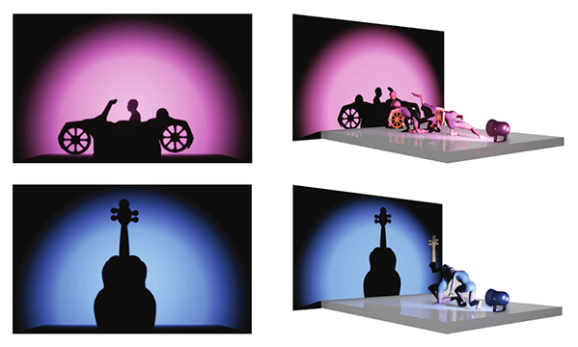
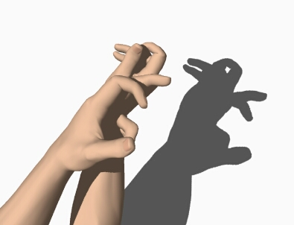
Background: Shadow art & computer graphics
Mitra and Pauly (2009)
Won and Lee (2016)
“SHADOWPIX”, Bermano et al. (2012)
“Freeform Shadow Boundary Editing”, Mattausch et al. (2013)
“EigenSkin”,
Kry et al. (2002)
Notes:
Niloy Mitra and Mark Pauly optimize geometry such that it casts multiple shadows when light is shone from different points.
Our work is similar in spirit, but optimizes for the initial ballistic motion of a set of occluders shaded by a single light source.
Won et al. solved character postures to match animated silhouettes. Their results demonstrate motion and physical plausibility, but avoid the non-linearities and discontinuities introduced by contact and dynamical motion
Other examples of shadow art too…

Slide 7
Background: Keyframing & guided physics
Rigid bodies
Fluids
Twigg and James (2008)
Thuerey et al. (2006)
Popovic et al. (2000)
“Spacetime constraints”, Witkin and Kass (1988)
Treuille et al. (2003)
Notes:
Twigg and James
They use a backwards time integration scheme that generate qualitatively plausible, but possibly unrealistic motions.
We prefer to use a forward time integration and stochastic optimization with reliable physical and contact models.
Easier to implement , and we don’t know the end configuration a priori.
The work by Popovic et al and witkin and kass solves a boundary value problem.
Ours: Initial value is the 3D configuration of the occlude objects, and the end value is defined by the 2D shape of the shadow.

Slide 8
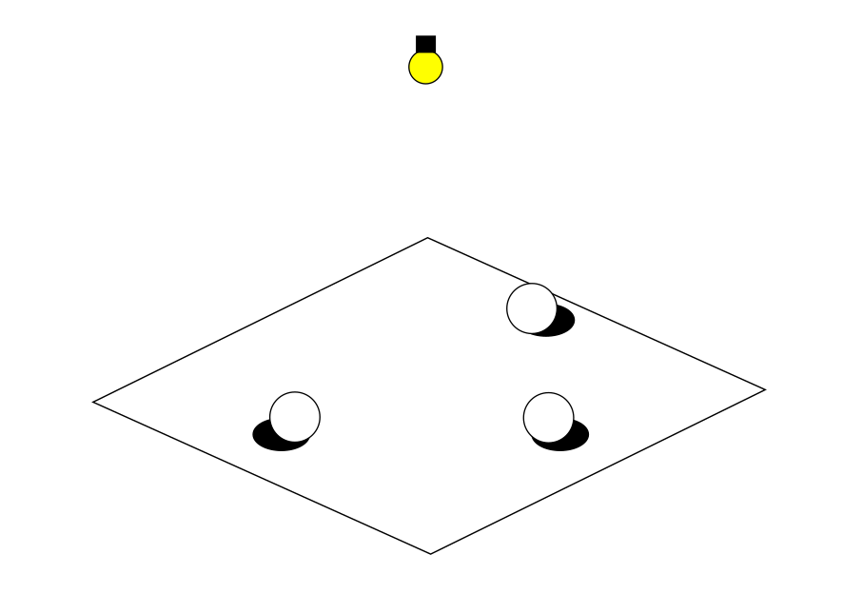
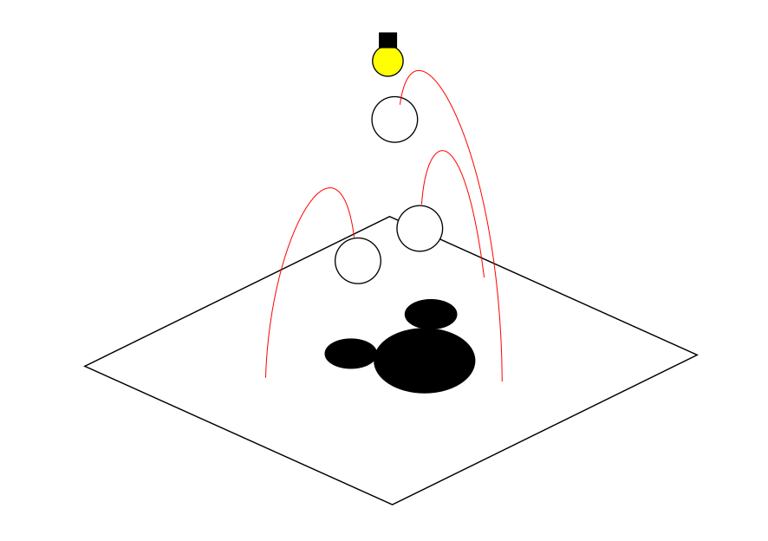

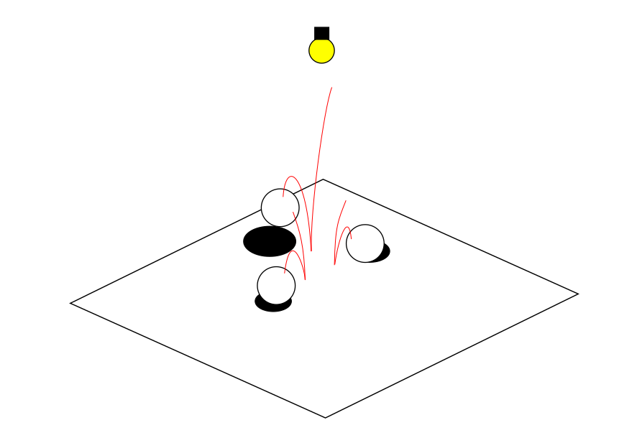
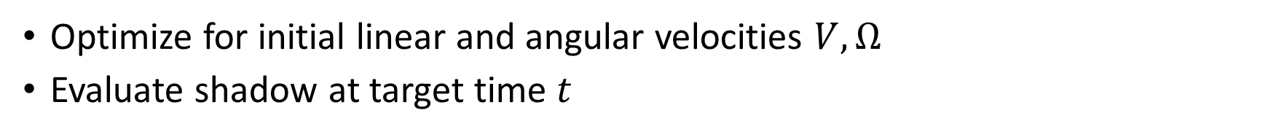


Overview
CMA-ES
Optimal trajectory
Scene initialization:
Ballistic shadow optimization
$$\underset{V,Ω}{arg min}{E_{image}+E_{physics}+E_{scene}}$$
$$V^{∗},Ω^{∗}$$
Physics simulation
I_{target}
time = 0
time = t
I_{shadow}
Optimize for initial linear and angular velocities $V, Ω$
Evaluate shadow at target time $t$
Notes:
Start with a scene containing a set of occluders, a light, and plane
Initial configuration defined by the user
Also have a binary image containing the target shadow
Stochastic optimization involves objectives related to the shadow image, the physics, and the scene configuration
Optimize for initial velocity

Slide 9
Energy functions

Slide 10
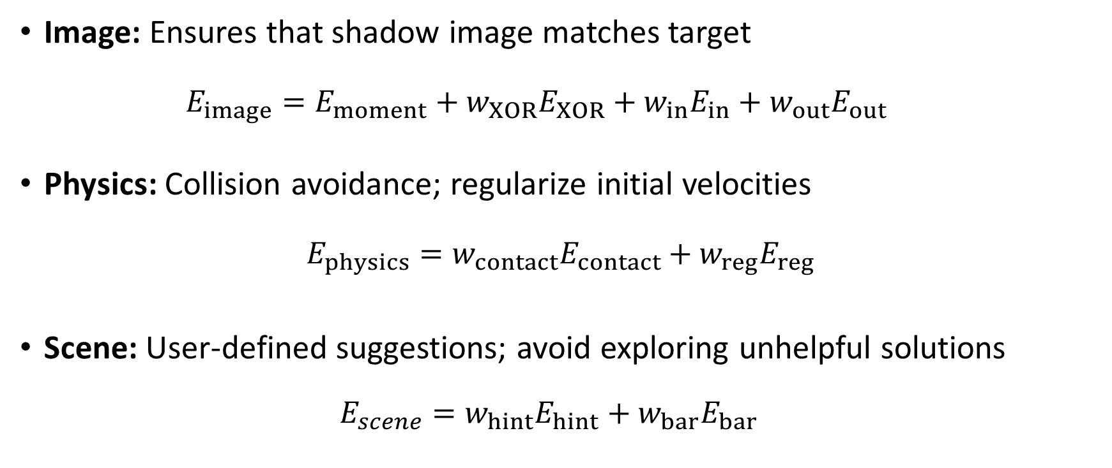
Optimization objectives
Image: Ensures that shadow image matches target
  $$E_{image}=E_{moment}+w_{XOR}E_{XOR}+w_{in}E_{in}+w_{out}E_{out}$$
Physics: Collision avoidance; regularize initial velocities
$$E_{physics}=w_{contact}E_{contact}+w_{reg}E_{reg}$$
Scene: User-defined suggestions; avoid exploring unhelpful solutions
$E_{scene}=w_{hint}E_{hint}+w_{bar}E_{bar}$
Notes:
Weighted multi-objective optimization involving many different types of objectives
The heart of our framework is in specifying these energy function and enabling/disabling them
The w’s are weights (see paper for typical values used in our results)
Some of these objective terms introduce non-linearities and discontinuities

Slide 11

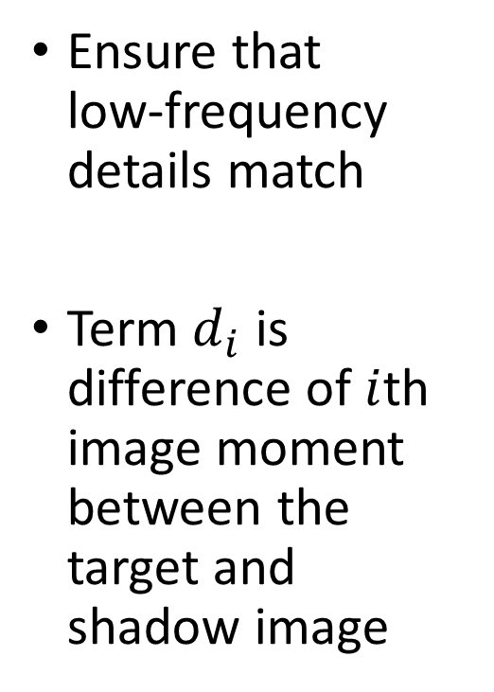
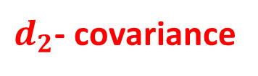




Image: Difference of image moments
$$I_{target}$$
Ensure that
low-frequency details match
Term $d_{i}$ is difference of $i$th image moment between the target and shadow image
$d_{1}$- centroid
$d_{2}$- covariance
$d_{0}$- area
$$I_{shadow}$$
$$E_{moment}=\sum_{i=0}^{2}{w_{i}\left\|d_{i}\right\|}$$
Notes:
But, even though the image moments match, it’s possible that the images don’t…

Slide 12
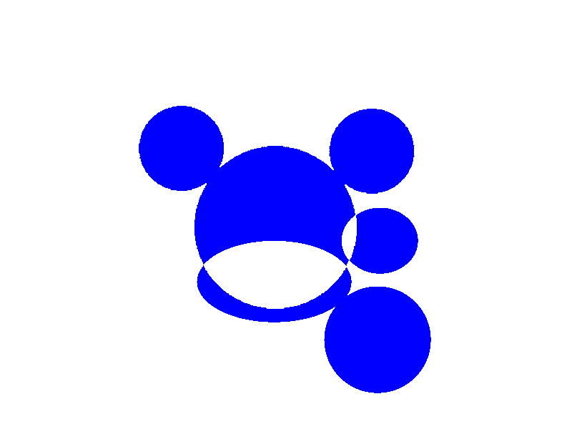
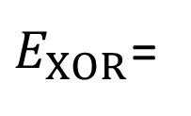
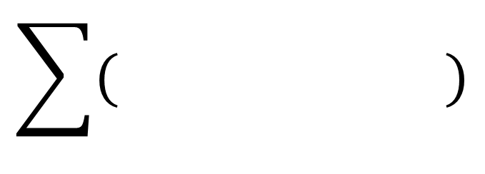
Image: XOR difference of images
Exclusive OR computed over binary images
Minimize sum of pixel differences between target and actual shadow
$E_{XOR}$=
Notes:
The main image objective. Ensures detail matching in the target and shadow images
Can use just these and the image moment results to find a solution… but can take a long time!
Other objectives to help with convergence

Slide 13
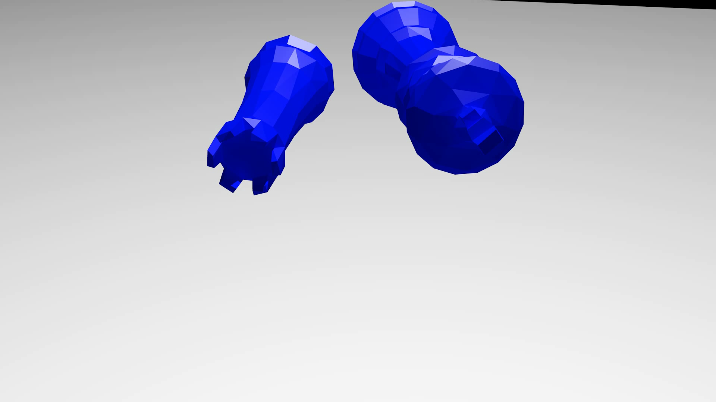

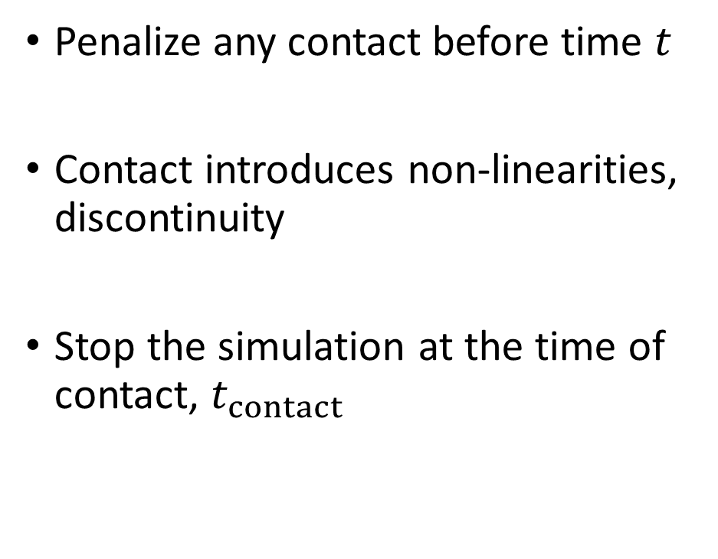
Physics: Contact penalty
Penalize any contact before time $t$
Contact introduces non-linearities, discontinuity
Stop the simulation at the time of contact, $t_{contact}$
$$E_{contact}=(t−t_{contact})$$

Slide 14
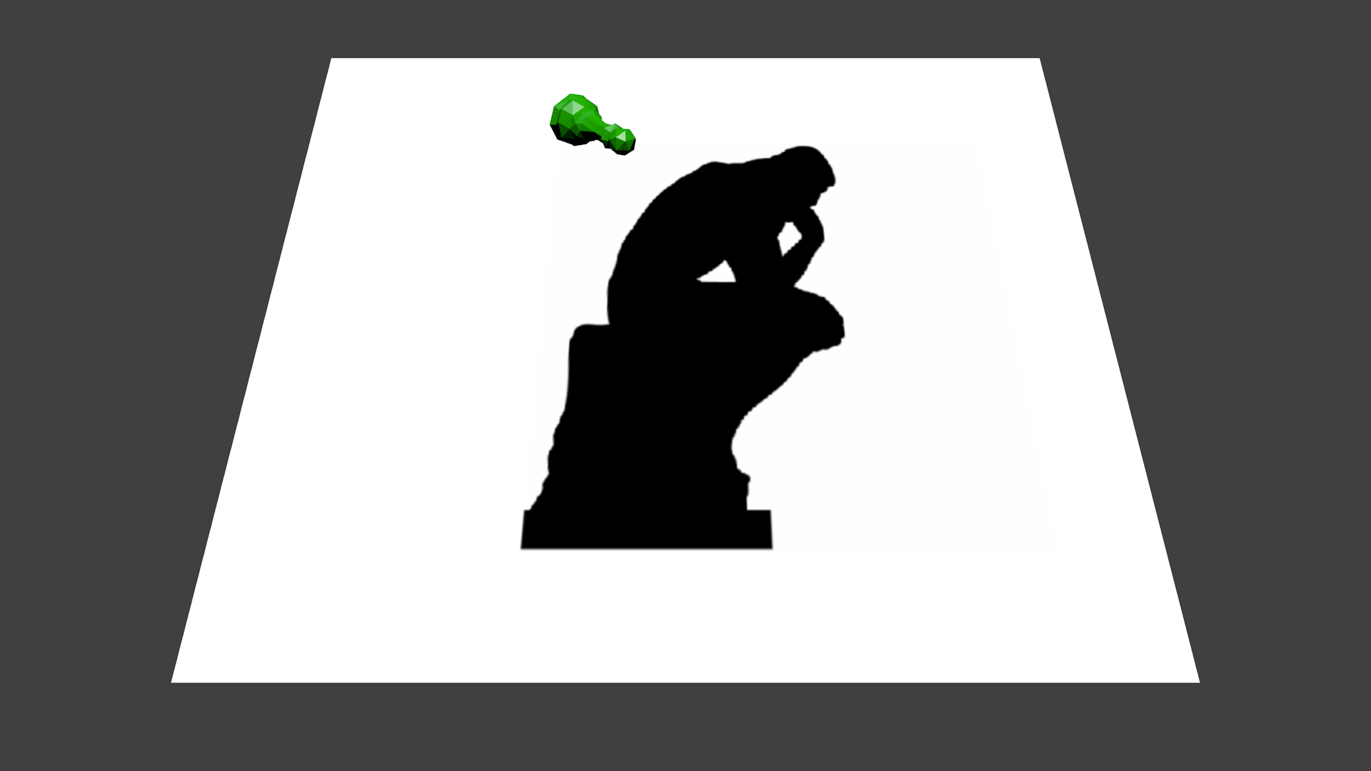
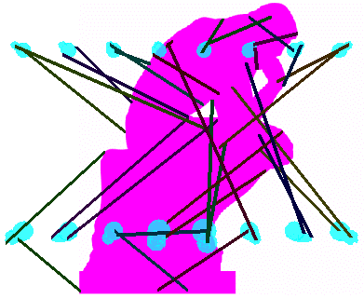

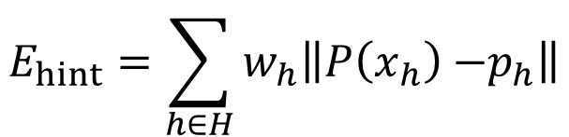

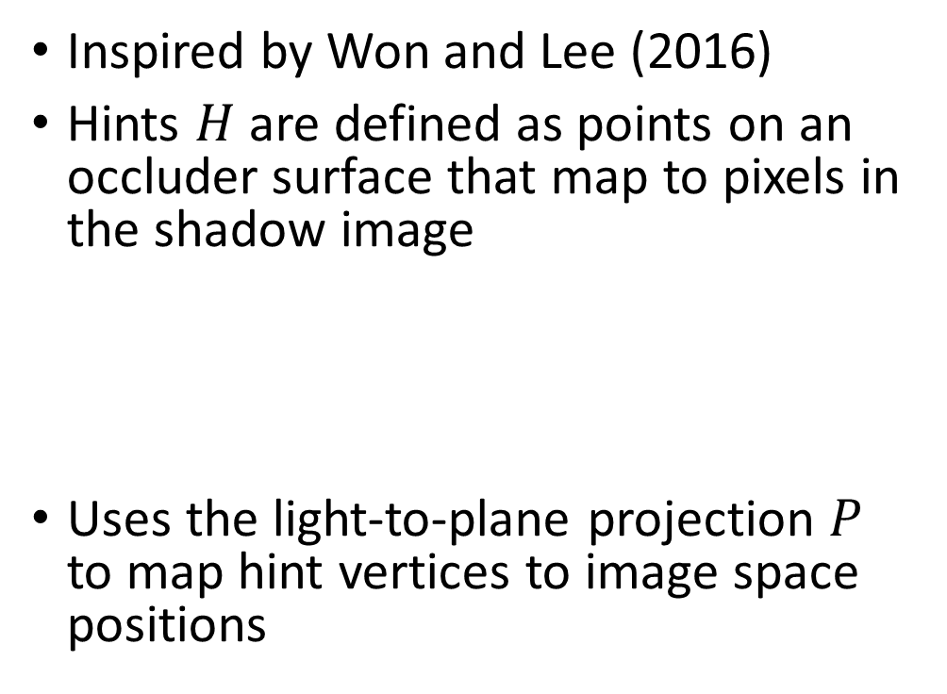

Scene: User-define hints
$$x_{h}$$
Inspired by Won and Lee (2016)
Hints $H$ are defined as points on an occluder surface that map to pixels in the shadow image
Uses the light-to-plane projection $P$ to map hint vertices to image space positions
$$P(x_{h})$$
$$E_{hint}=\sum_{h∈H}{w_{h}\left\|P\left(x_{h}\right){−p}_{h}\right\|}$$
$$p_{h}$$

Slide 15

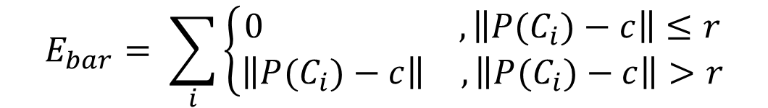





Scene: Barrier function
Penalizes occluders that cast shadow outside the image region
$$E_{bar}= \sum_{i}{\left\{\begin{aligned}\begin{matrix}0 & , \left\|P(C_{i})−c\right\|≤r\end{matrix} \\ \begin{matrix}\left\|P(C_{i})−c\right\| & ,\left\|P(C_{i})−c\right\|>r\end{matrix}\end{aligned}\right.}$$
Barrier function
$$C_{2}$$
$$C_{1}$$
$P(C_{1}$)
$$c$$
$P(C_{2}$)
Shadow image region
$$r$$
Notes:
Prevents occluders from not contributing to the scene.
Project center of mass of occluders using the light-to-plane projection matrix

Slide 16
Convergence strategies and refinement
Notes:
Some strategies we explored to improve the rate of convergence towards plausible solutions
Boundary shape tends to be most noticeable, so we refine it

Slide 17
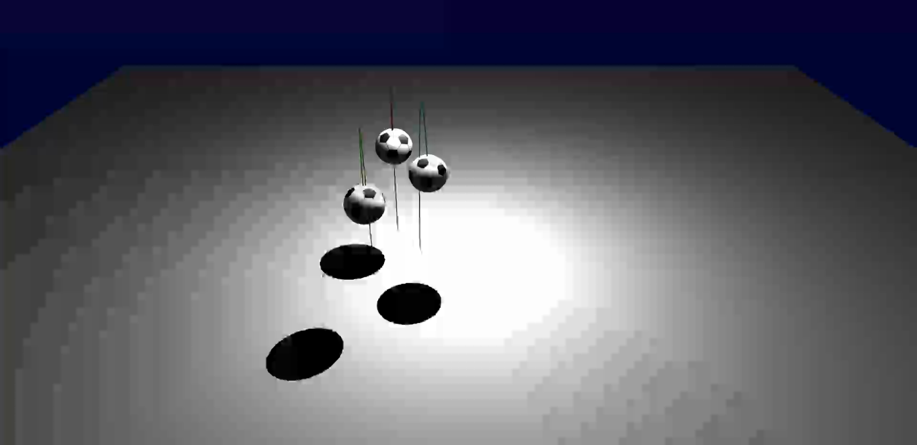
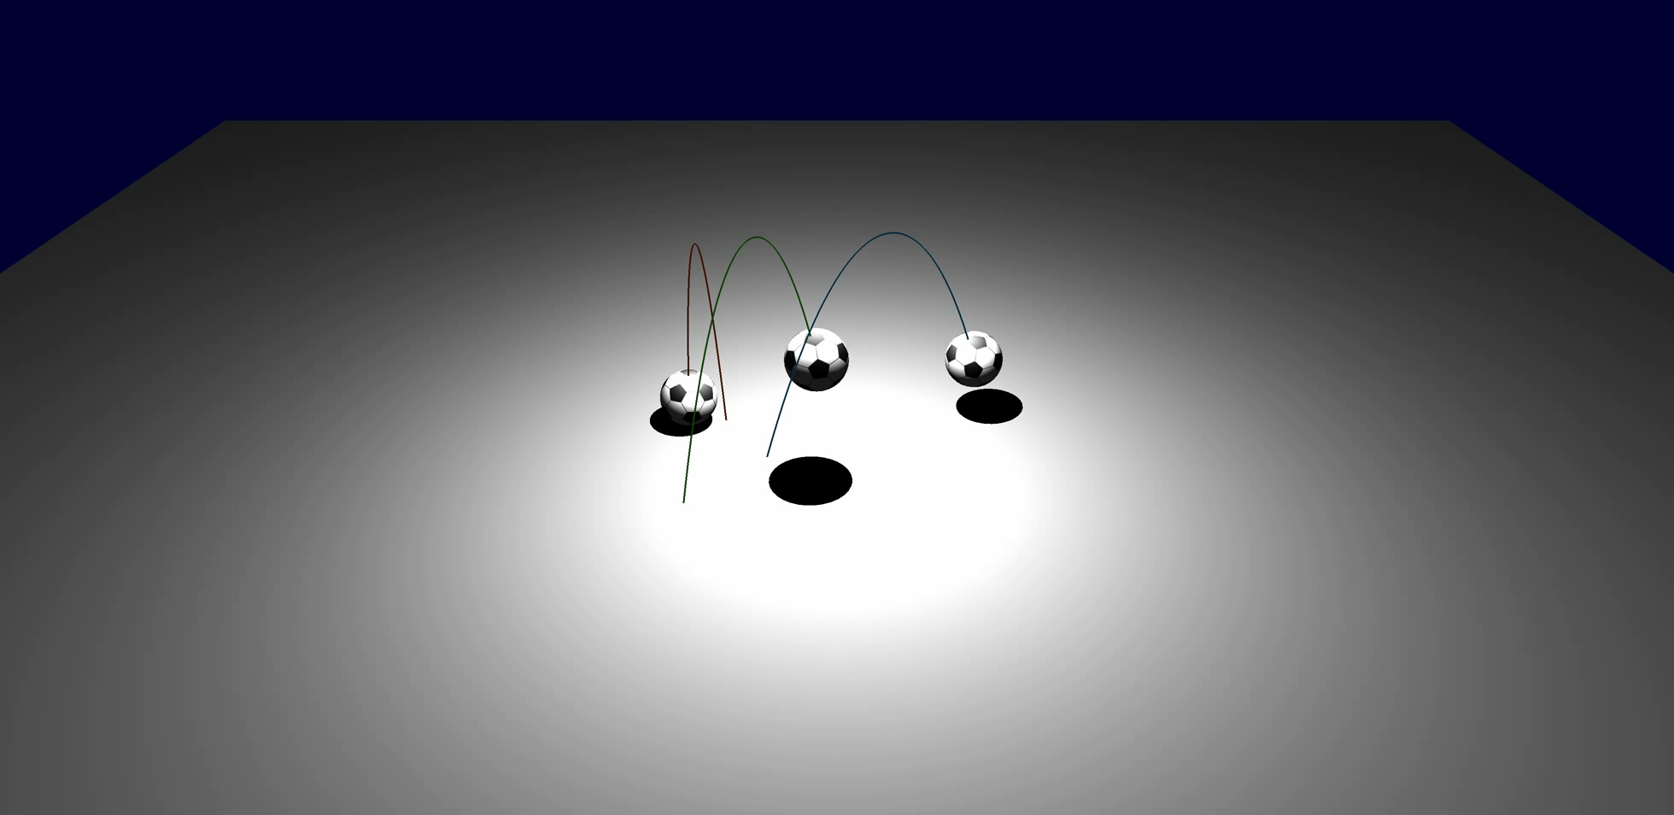


Strategy 1: Multi-stage optimization
Improve convergence during initial exploration
Start with an easier minimization problem
Stage 1
Stage 2
$w_{XOR}=0$, $w_{reg}=0.01$
$w_{XOR}=300$, $w_{reg}=0.1$
Notes:
Discontinuous error landscape wrought with local minima
Gradually “dial-in” nasty energy functions
Stage 1: disable the XOR objective;
The image moments, barrier function tend to dominate
Stage 2: enable the XOR image objective, increase the velocity regularization

Slide 18
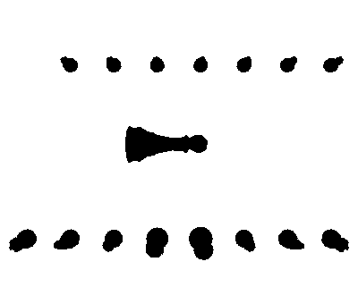
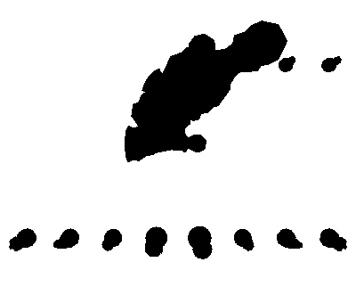
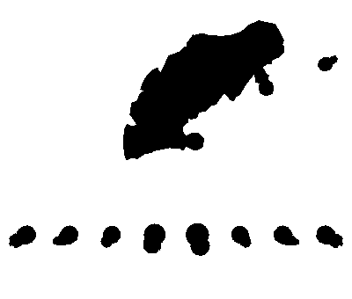
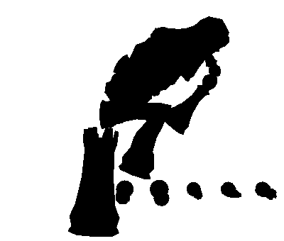
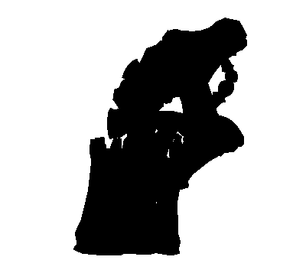
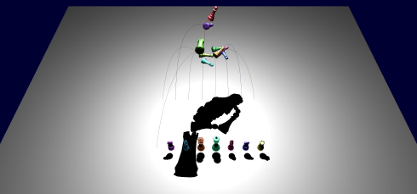
Strategy 2: Sequential optimization
Optimize just one occluder at a time, fix all others
…
…
…
…
0
3
6
9
15
Notes:
When occluders are launched from clustered positions, most of the early solutions produce motions that cause collisions
Even small deviations result in drastically different solutions
DIFFICULT TO MAKE PROGRESS

Slide 19
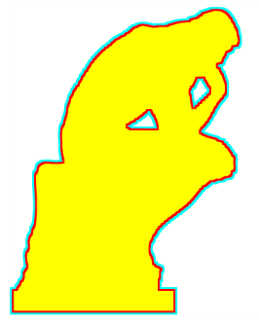
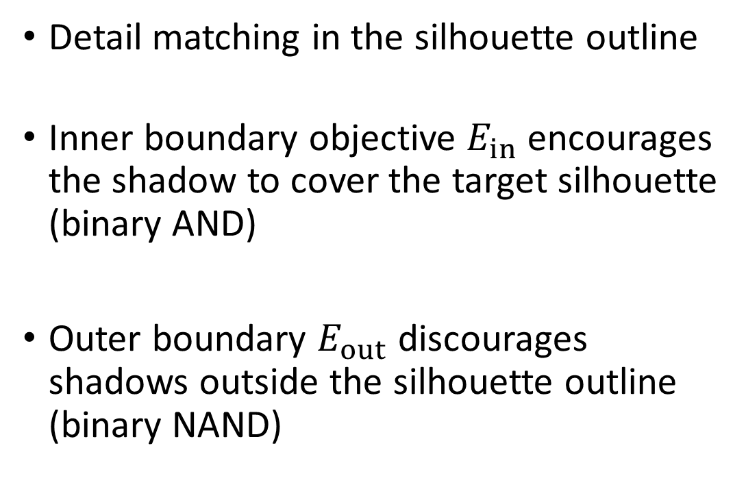
Extra stage: Boundary refinement
Detail matching in the silhouette outline
Inner boundary objective $E_{in}$encourages the shadow to cover the target silhouette
(binary AND)
Outer boundary $E_{out}$ discourages shadows outside the silhouette outline
(binary NAND)
Outer boundary
Inner boundary
Notes:
Red line is the inner boundary
Cyan line is the outer boundary
Note: yellow image region is ignored…

Slide 20
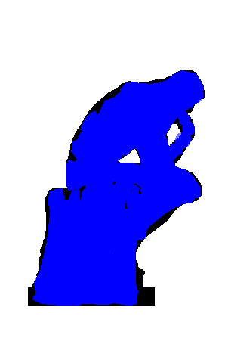
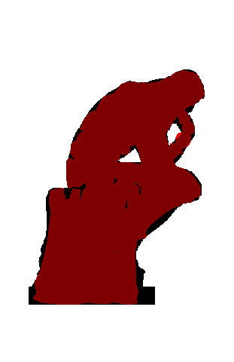
Extra stage: Boundary refinement
without
with
Notes:
Note the improved matching along the back of the Thinker.
This was the only example we used for boundary refinement

Slide 21
Results

Slide 22
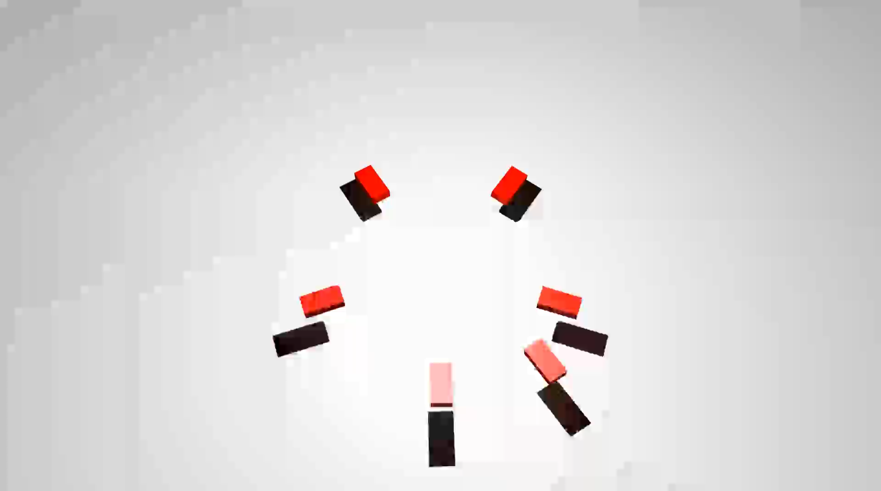

“Fly” (Chinese)
½ speed
Notes:
Note: These are raytraced in Blender, not using planar shadow technique used by the optimization

Slide 23
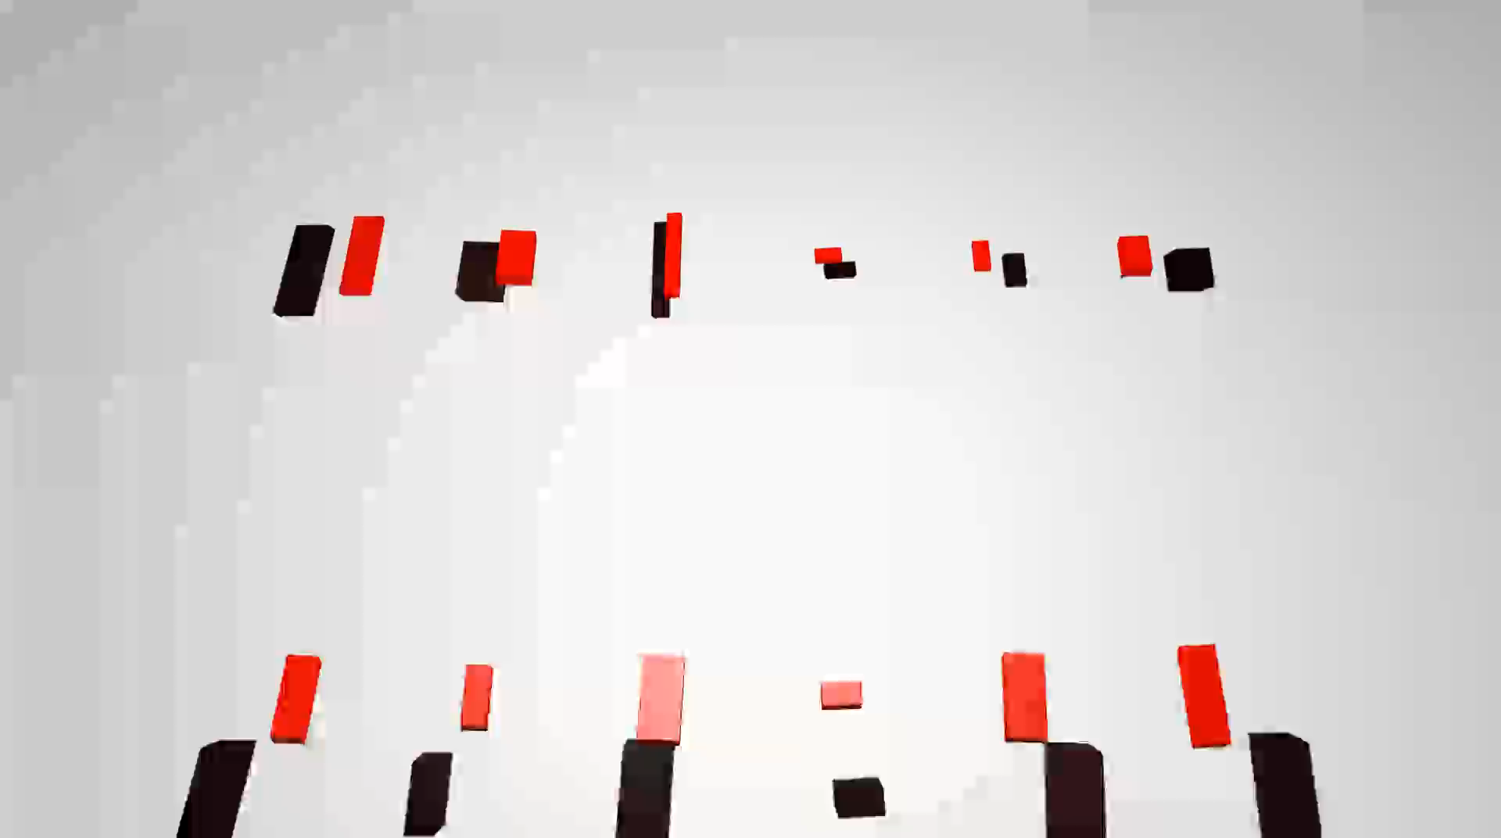
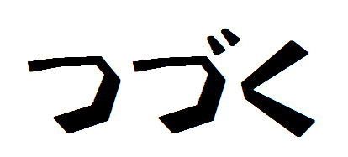
“To Be Continued” (Japanese)
½ speed

Slide 24
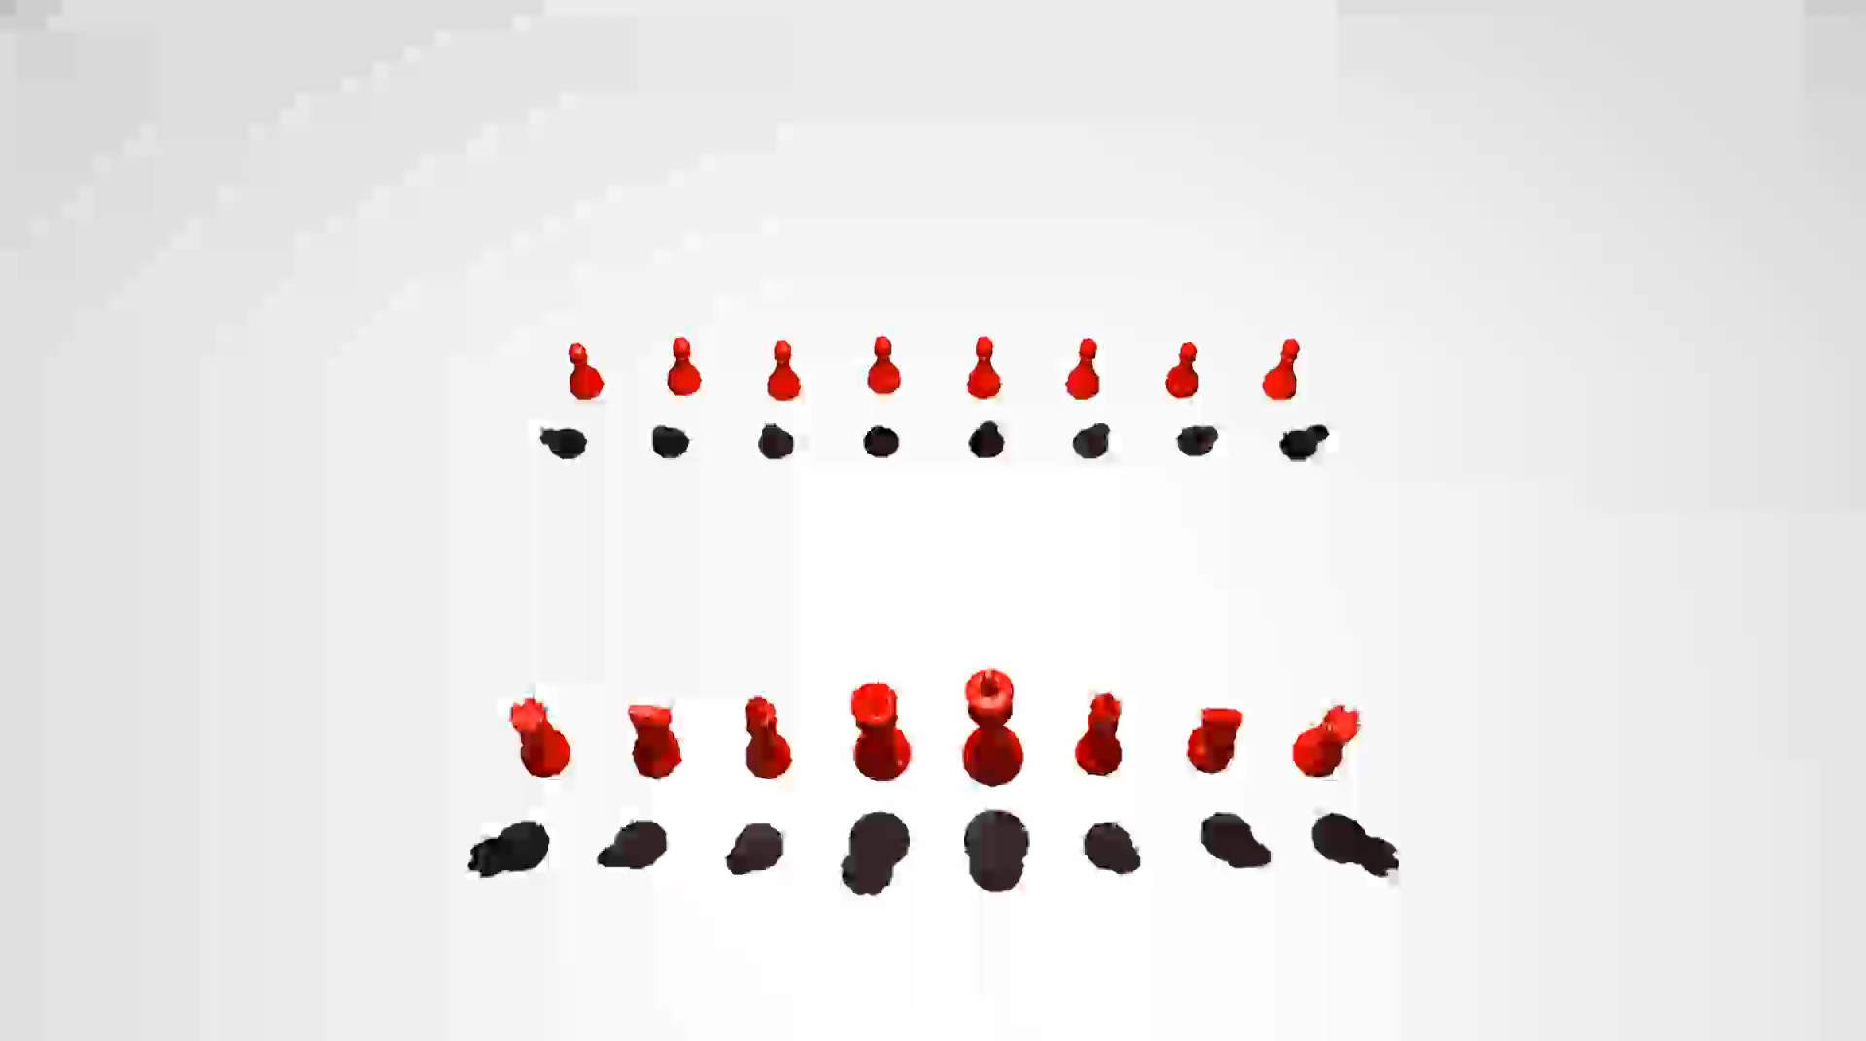

“The Thinker”
½ speed

Slide 25

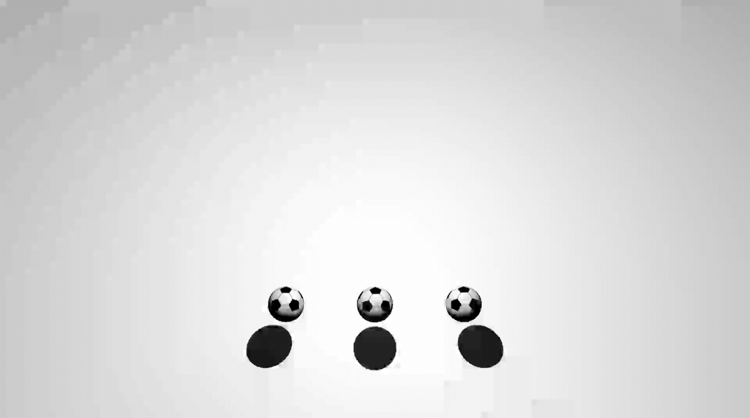




Multiple starting configurations
Mickey six ways

Slide 27
Limitations
Planar surfaces only with hard shadows
Short-lived, transient effect (don’t blink!)
Allow rotated/scaled/translated solutions
Single threaded implementation
Notes:
Transient effect is both a shortcoming and highlight of our work... Meaningful and special!

Slide 28
Conclusion
Summary: A semi-automatic framework for generating shadow art via ballistic motion, using stochastic optimization and rigid body physics.
Future work:
- Shadow maps
- Increased duration of shadow shape
- Optimize for light position, time
- Multiple targets, e.g. by collision response
- Physical realization and fabrication
Notes:
Increased duration of shadow shape
Minimize velocity at time
XOR image comparison over time window

Slide 29



Thank you!
Questions?

Slide 30
“The Thinker”
½ speed

Slide 32



Slide 33


Image comparison objectives
Ensure that shadow image at time $t$ matches target image
$$E_{image}=\sum_{i=1}^{2}{w_{i}d_{i}}+w_{XOR}E_{XOR}+w_{in}E_{in}+w_{out}E_{out}$$
Difference of
image moments
Image difference
Inner boundary
matching
Outer boundary
avoidance

Slide 34




Image moments
$$M_{0}=\sum_{x}{\sum_{y}{I(x,y)}}$$
0th moment (area):
1st moment (centroid):
2nd moment (covariance):
$$M_{1}=\frac{1}{M_{0}}\left(\begin{matrix}\sum_{x}{\sum_{y}{x I(x,y)}} \\ \sum_{x}{\sum_{y}{y I(x,y)}}\end{matrix}\right)=\left(\begin{matrix}\overline{x} \\ \overline{y}\end{matrix}\right)$$
$$M_{2}=\left(\begin{matrix}μ_{20} & μ_{11} \\ μ_{11} & μ_{02}\end{matrix}\right)$$
$$μ_{pq}=\frac{1}{M_{0}}\sum_{x}{\sum_{y}{{\left(x−\overline{x}\right)}^{p}{\left(y−\overline{y}\right)}^{q} I(x,y) }}$$

Slide 35


$E_{reg}$: Regularization
Minimize velocities
Velocity regularization:
$$E_{reg}=α\sum_{v∈V}{\left\|v\right\|}+(1−α)\sum_{ω∈Ω}{\left\|ω\right\|}$$

